Slide 1

Business Intelligence Using Tableau/Power BI – Day 3

Slide 2


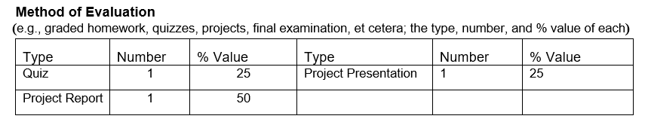

Slide 3
Format

Slide 4
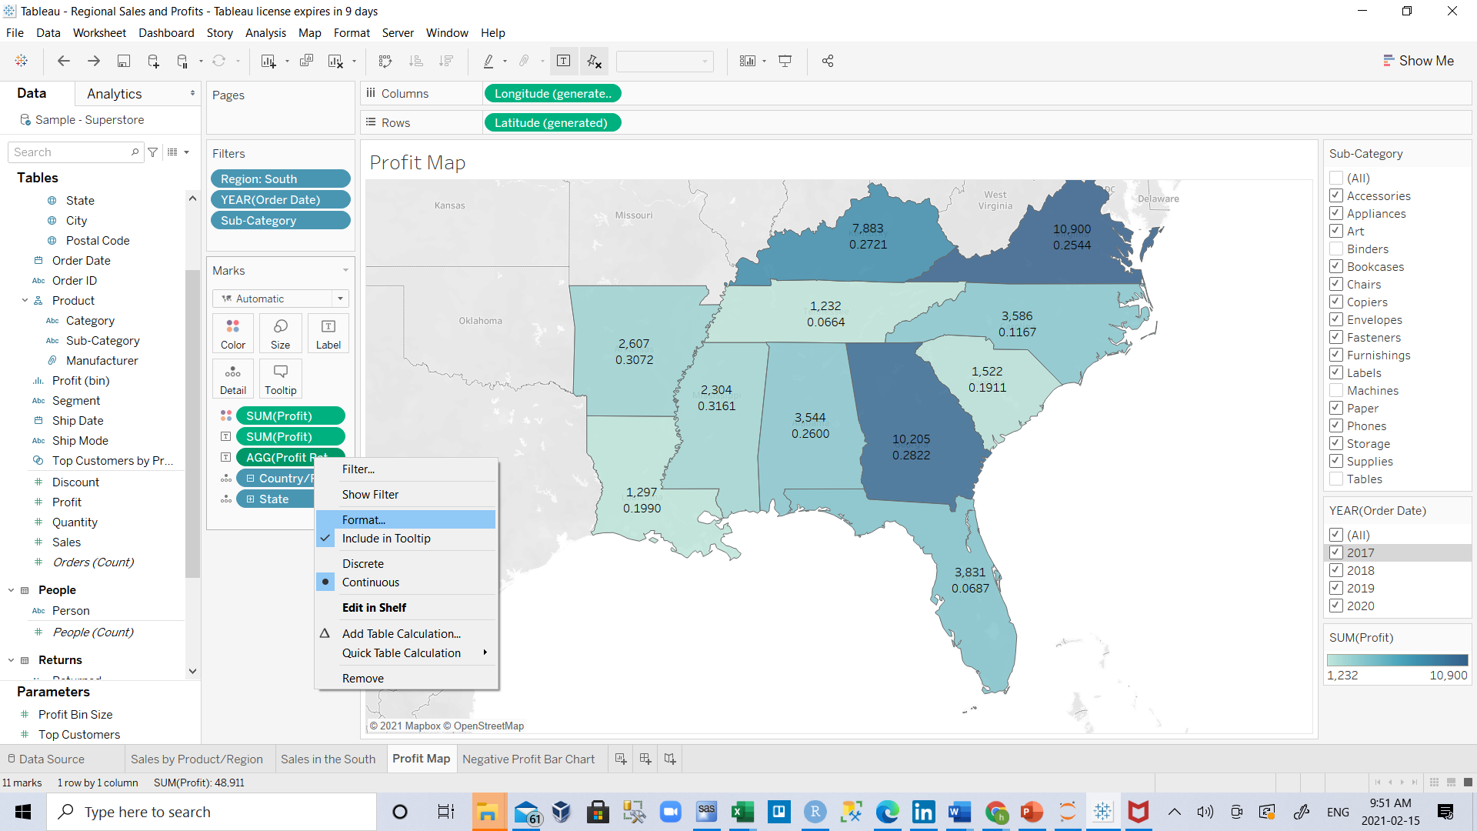
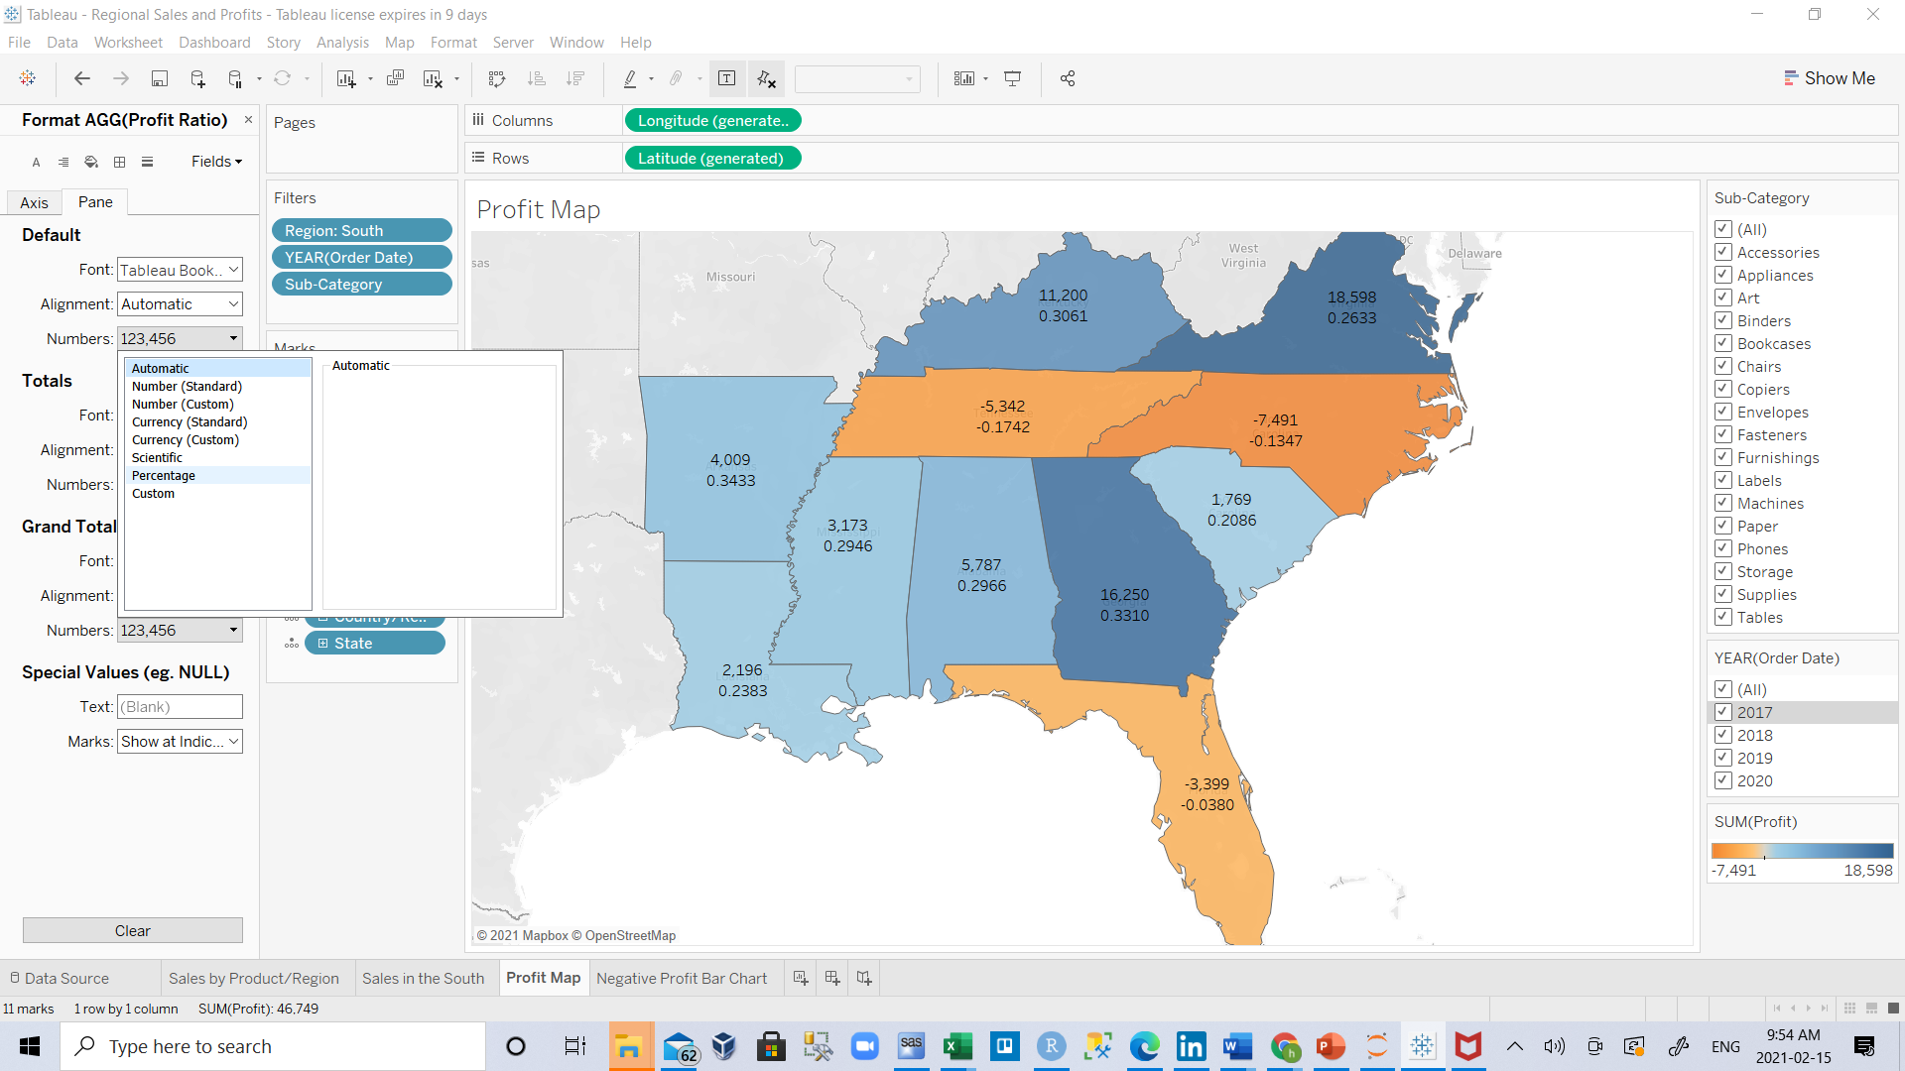
If you want to see Profit Ratio in percentage format , we dragged it to label
So right click on it and select Format.
From the format section that appears in Numbers section select Percentage

Slide 5

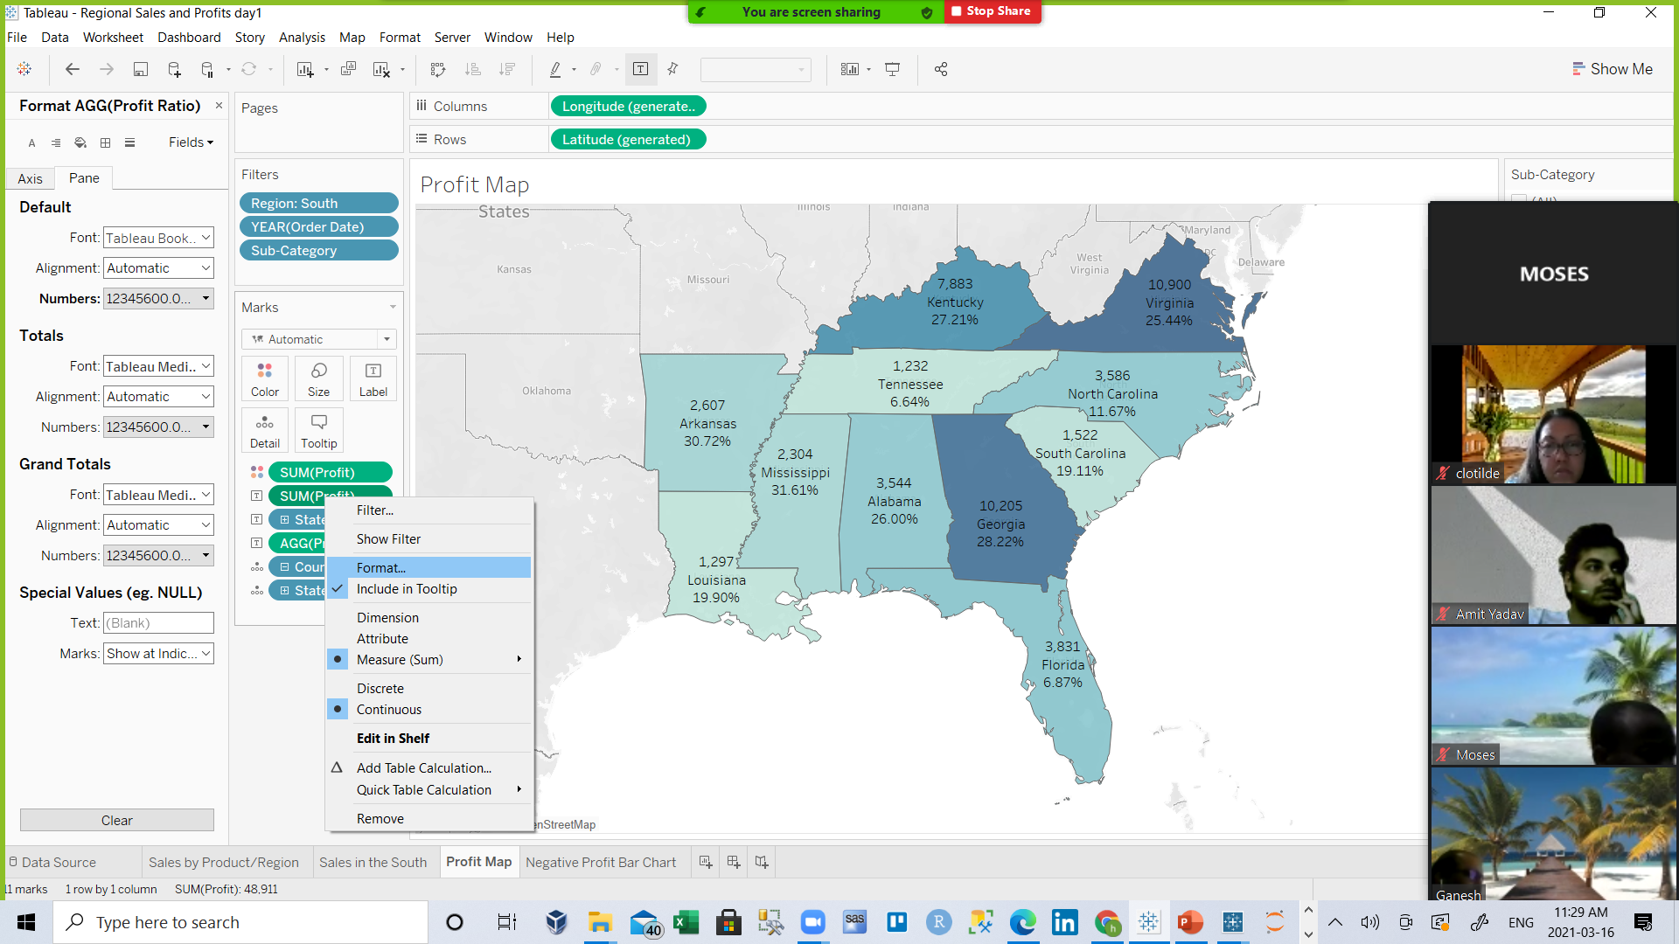
Do the same for profit and select Currency (standard)

Slide 6
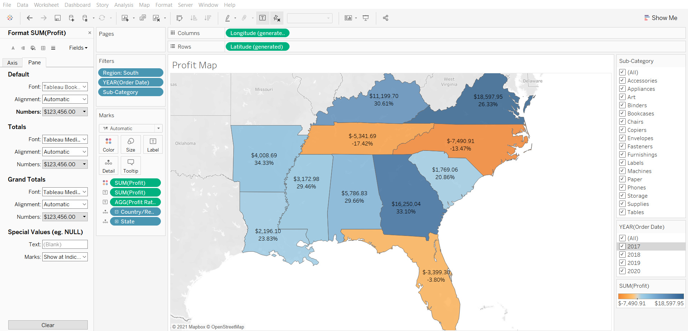
If you want to close format window hit x sign

Slide 7
T
Now you know that machines, tables, and binders are problematic products for your company. In focusing on the South, you see that these products have varying impact on profit. This might be a worthwhile conversation to have with your boss.
Next, you'll assemble the work you've done so far in a dashboard so that you can clearly present your findings.

Slide 8
Step 6: Build a dashboard to show your insights

Slide 9
T
You’ve created four worksheets, and they're communicating important information that your boss needs to know. Now you need a way to say, "Hey, here’s the deal. See how we've got negative profit in Tennessee, North Carolina, and Florida? This is one of the reasons why."
Tableau has an app for that, or at least a sheet: It's called a dashboard. You can use dashboards to display multiple worksheets at once, and—if you want—make them interact with one another.

Slide 10
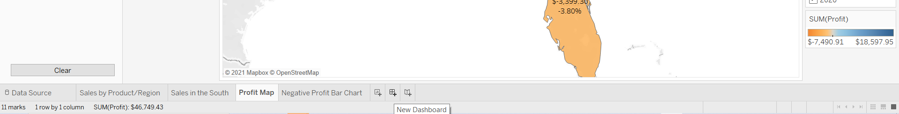
T
Set up your dashboard
You want to emphasize that certain items sold in certain places are doing poorly. Your bar graph view of profit and your map view demonstrate this point nicely.
Click the New dashboard button.

Slide 11
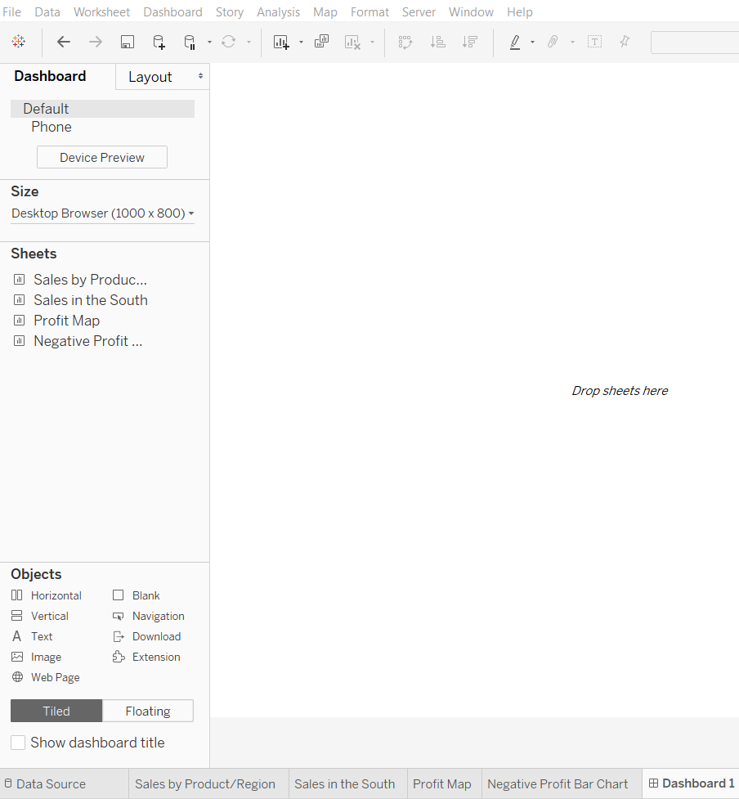
T
2.From the Dashboard pane on the left, drag Sales in the South to your empty dashboard.

Slide 12
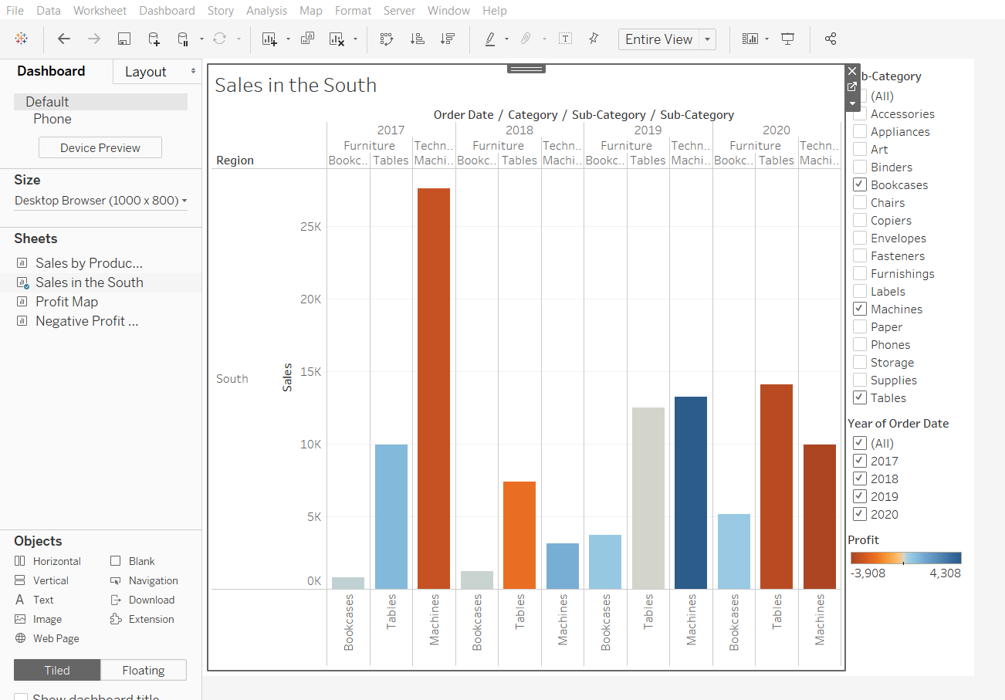
T
3. Drag Profit Map to your dashboard, and drop it on top of the Sales in the South view.
Your view will update to look like the next slide:

Slide 13
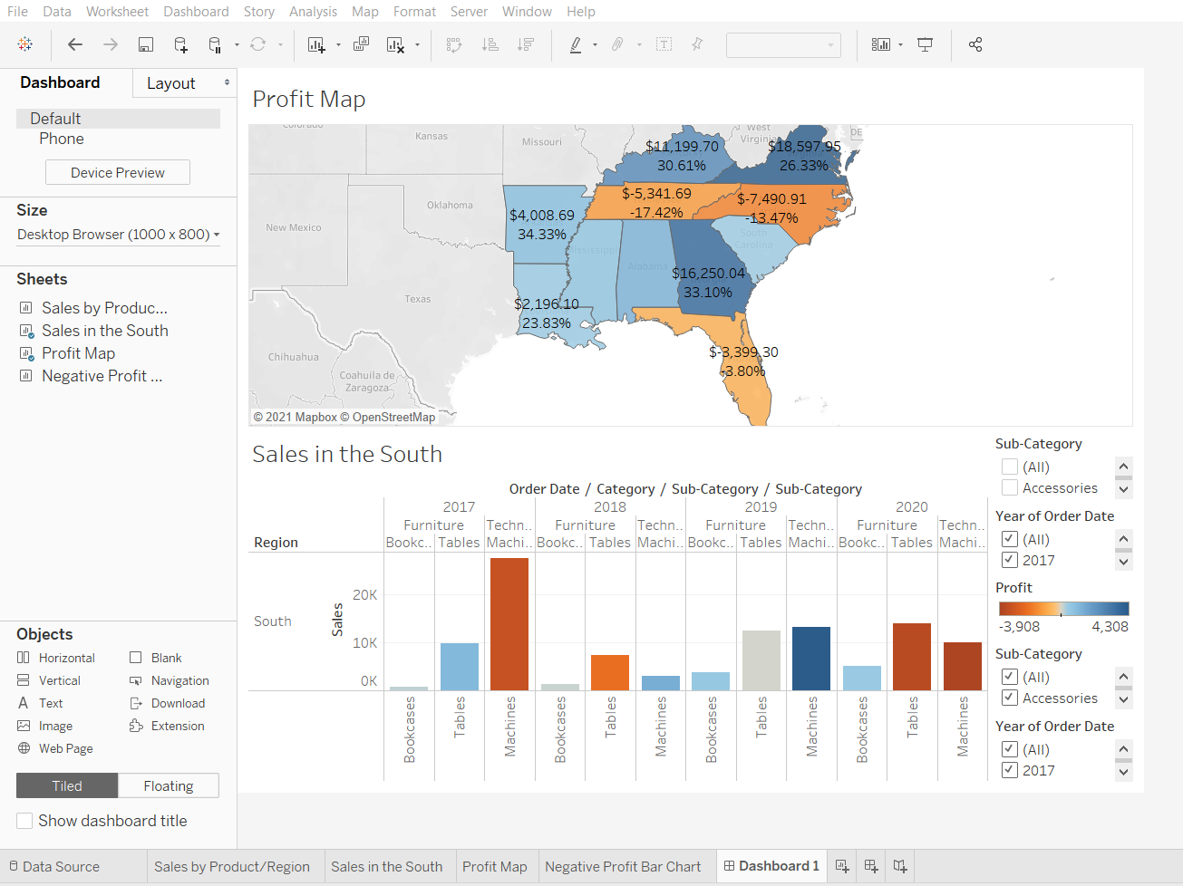
T
Now you can see both views at once. Nice!
Sadly, the bar chart is a bit squished, which isn’t helping your boss understand your data

Slide 14
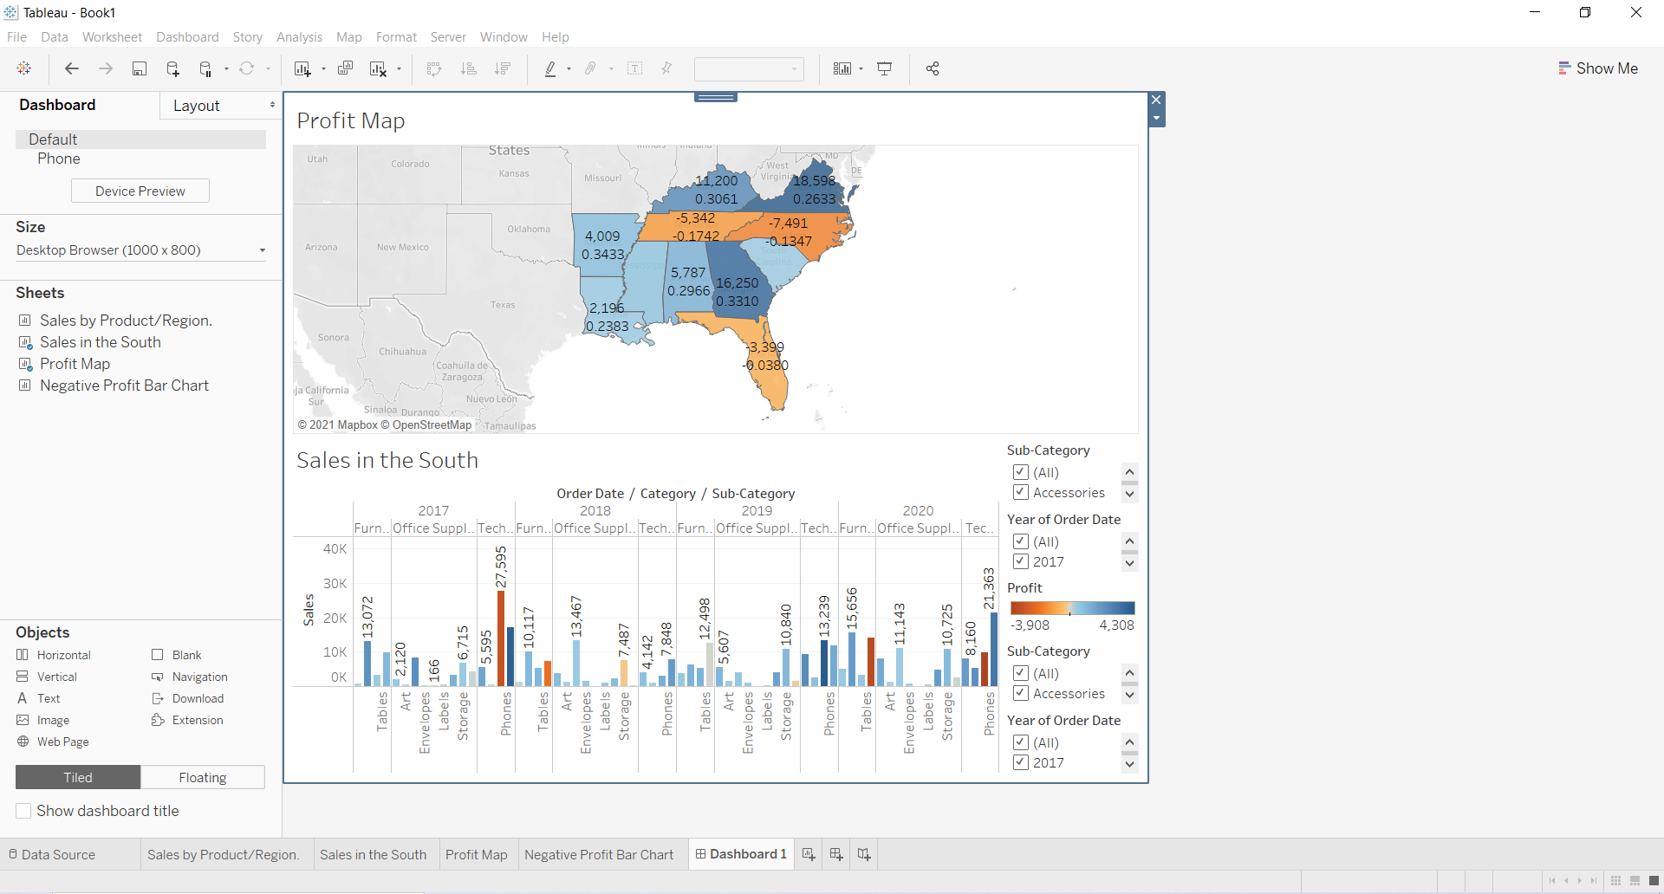
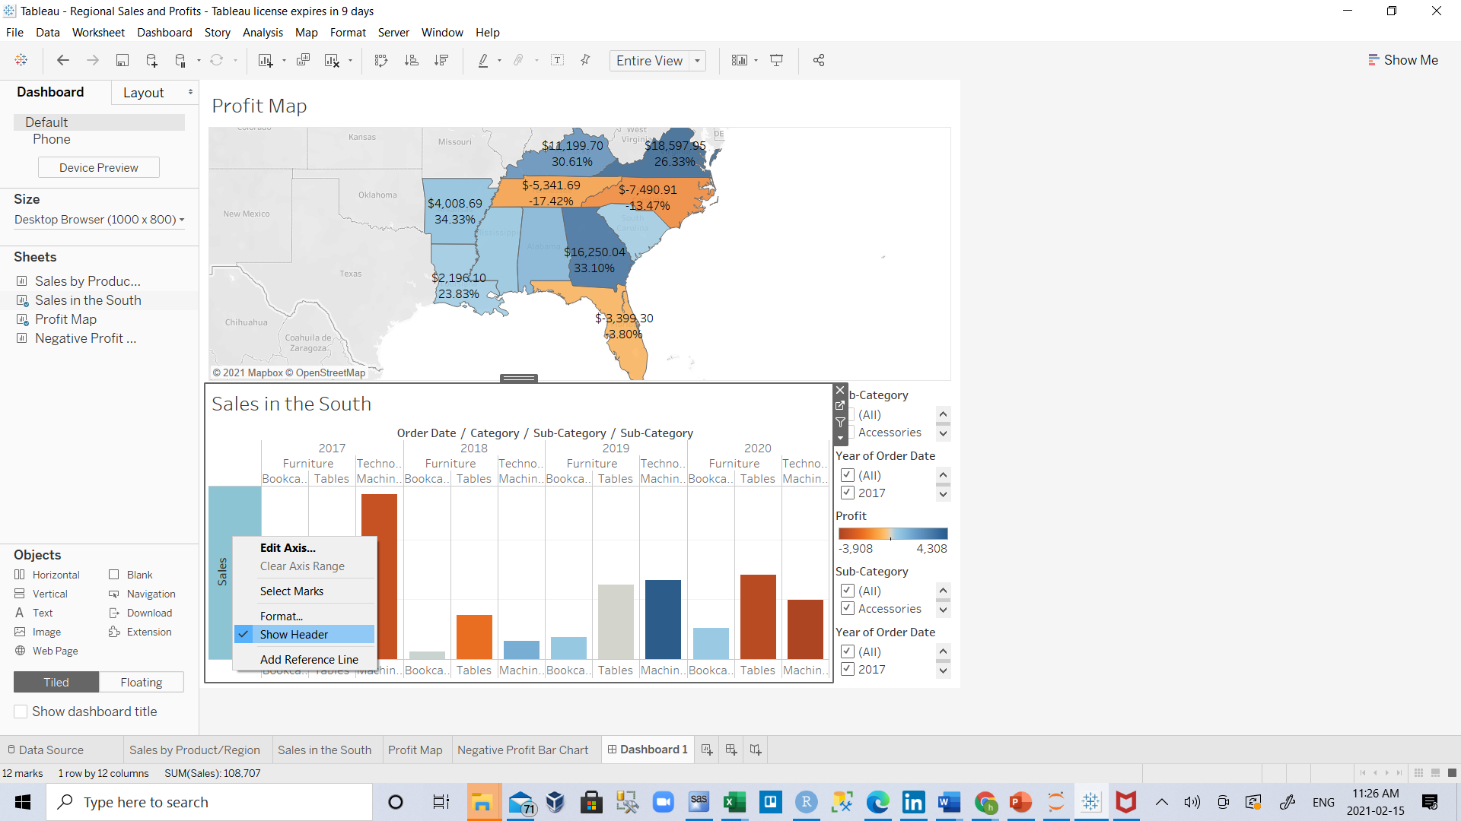
T
Arrange your dashboard
It's not easy to see details for each item in Sub-Category from your Sales in the South bar chart. Plus, because we have the map in view, we probably don't need the South region column in Sales in the South, either.
Resolving these issues will give you more room to communicate the information you need.
On Sales in the South, right-click in the column area under the Region for south column header, and clear Show header(uncheck it).

Slide 15
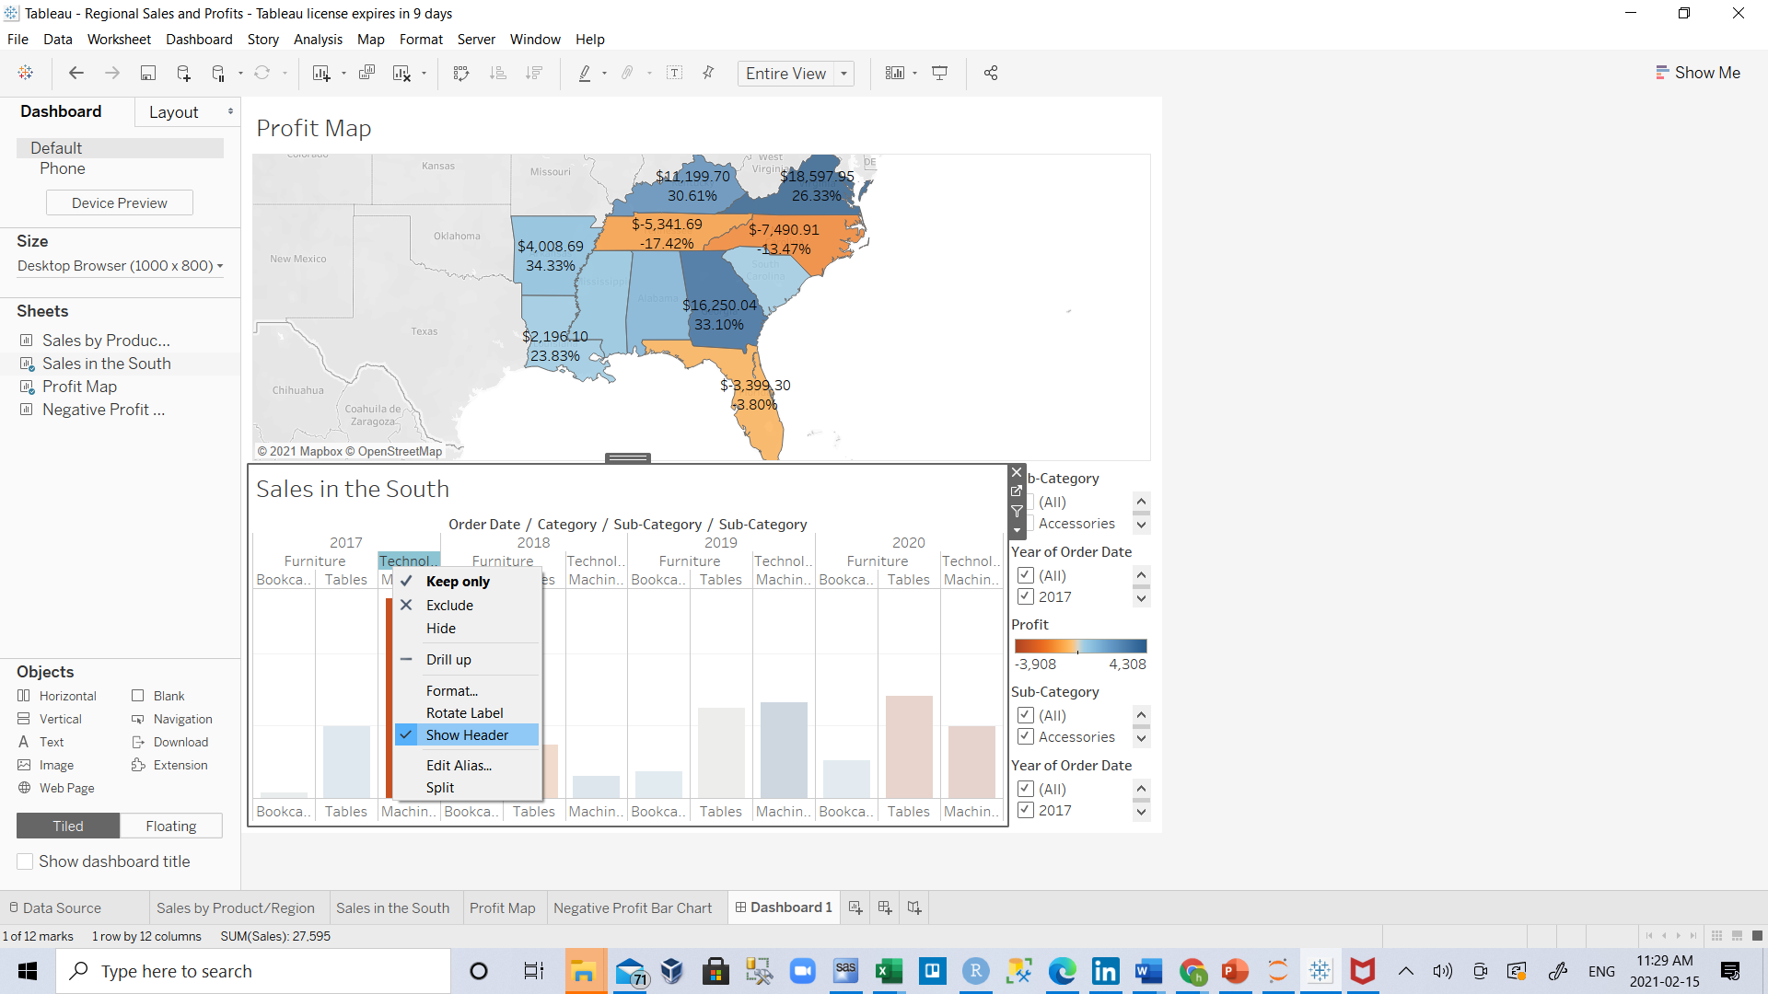
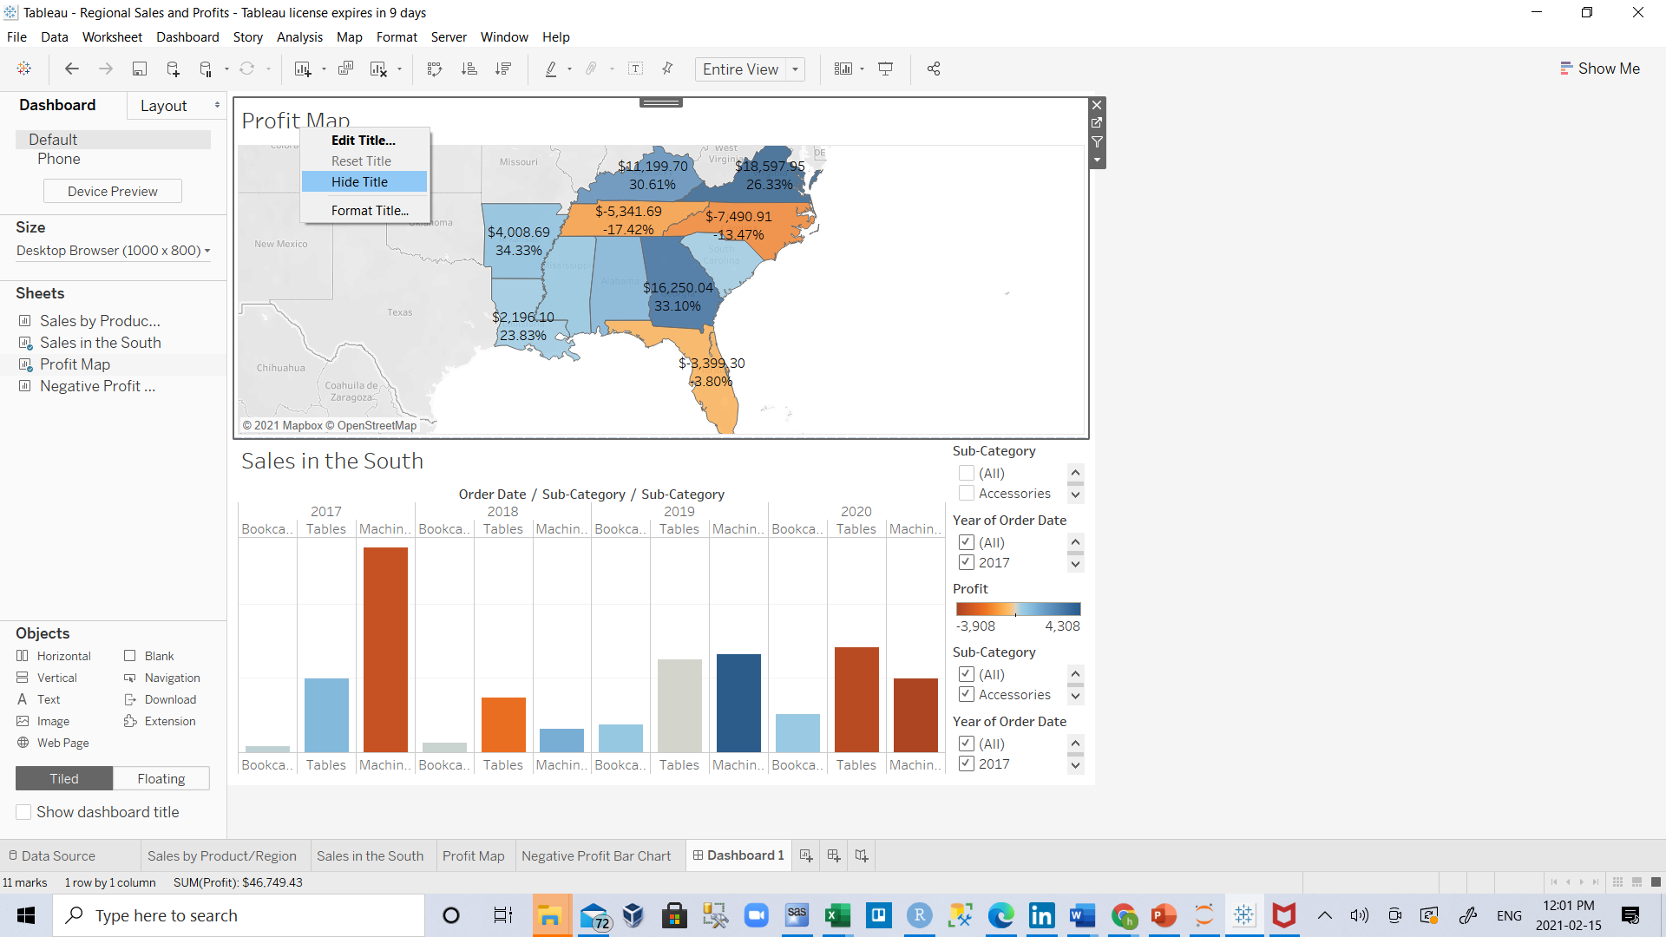
T
2.Repeat this process for the Category row header.
You've now hidden unnecessary columns and rows from your dashboard while preserving the breakdown of your data. Ah, the beauty of white space. (But, you could probably freshen things up even more.)
Right-click the Profit Map title and select Hide Title.
The title Profit Map is hidden from the dashboard and more space is created.
4.Repeat this step for the Sales in the South view title.

Slide 16
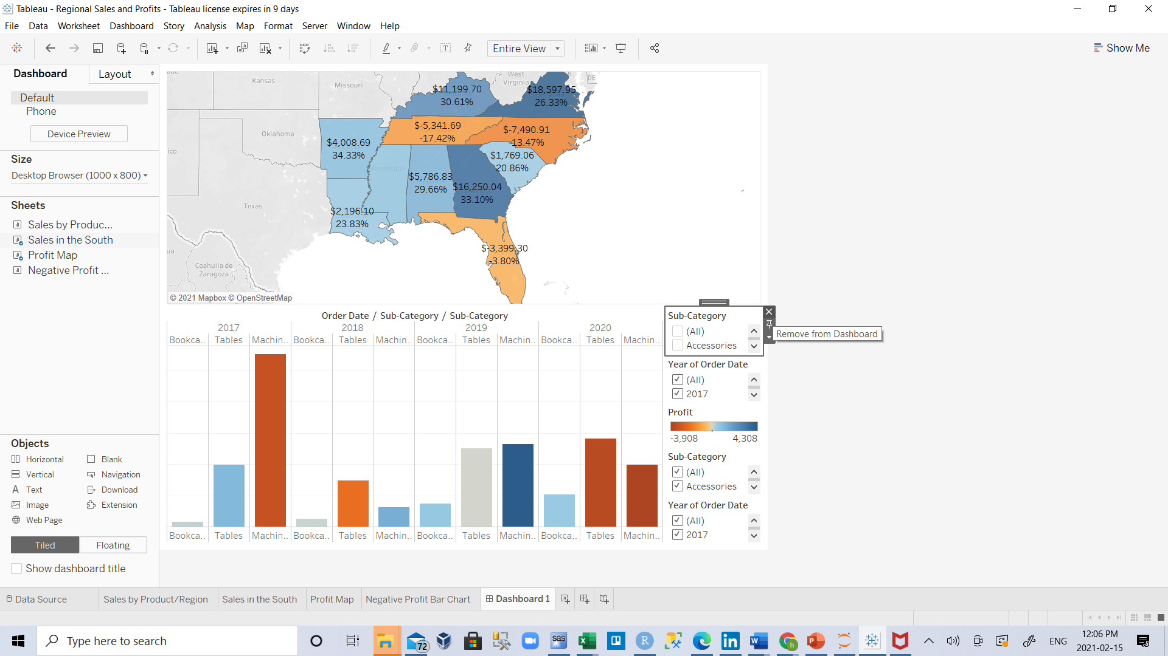
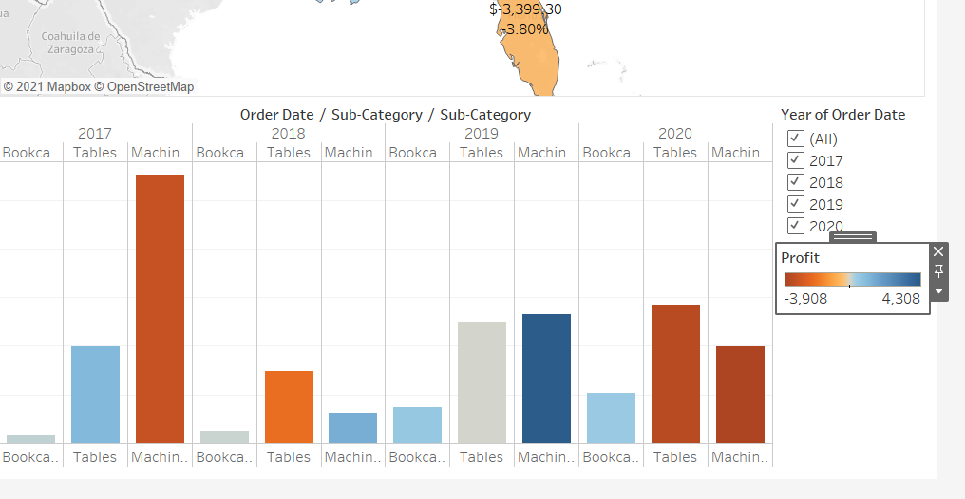
T
5.Select the first Sub-Category filter card on the right side of your view by left clicking, and at the top of the card, click the Remove icon .
Repeat this step for the second Sub-Category filter card and one of the Year of Order Date filter cards.
Click on the Profit color legend and drag it from the right to below Sales in the South.

Slide 17
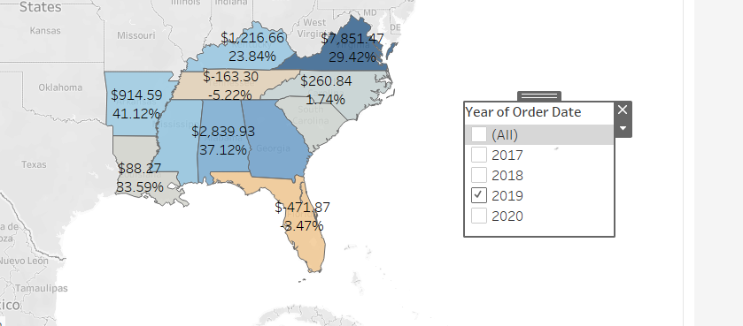
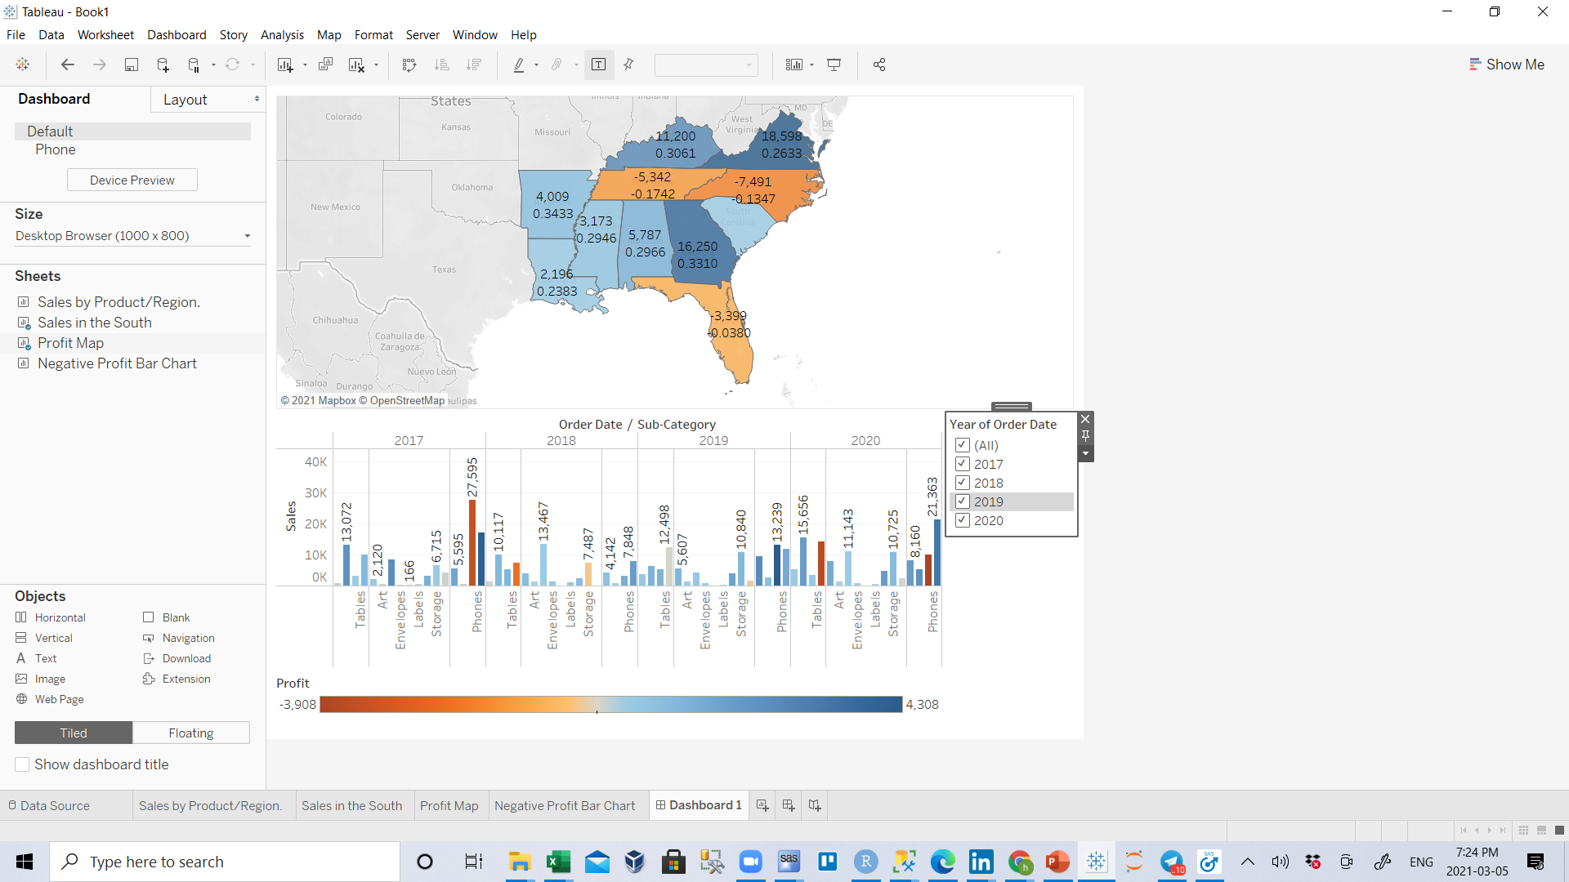
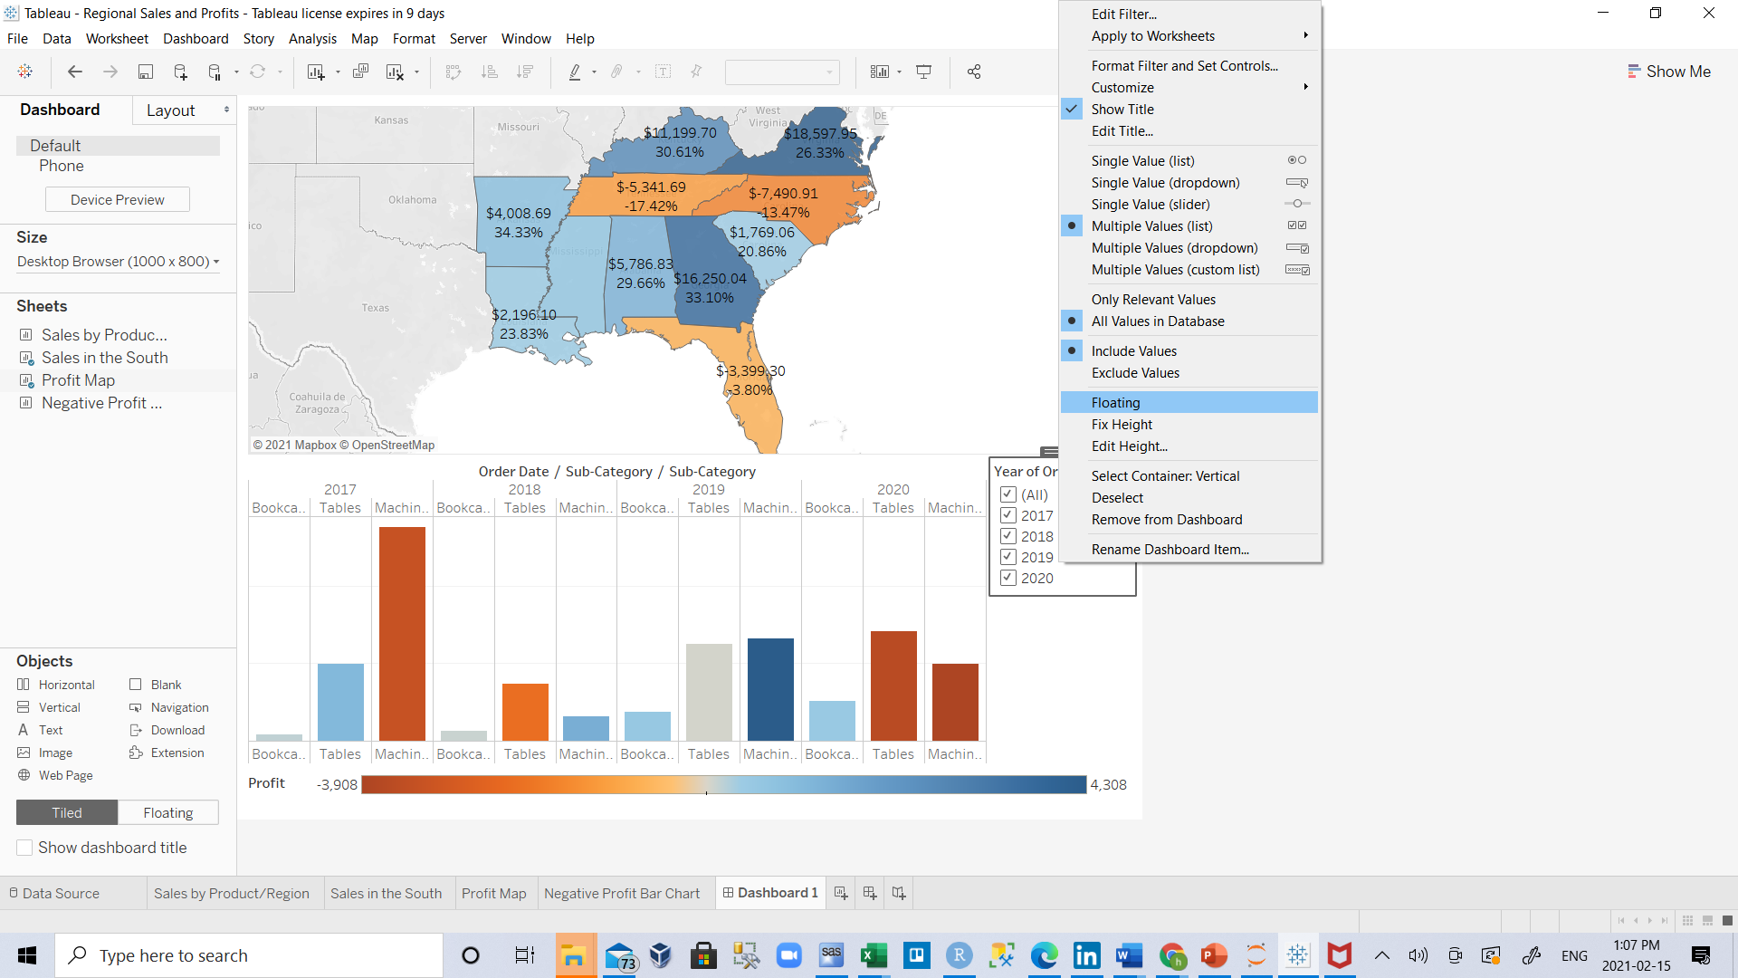
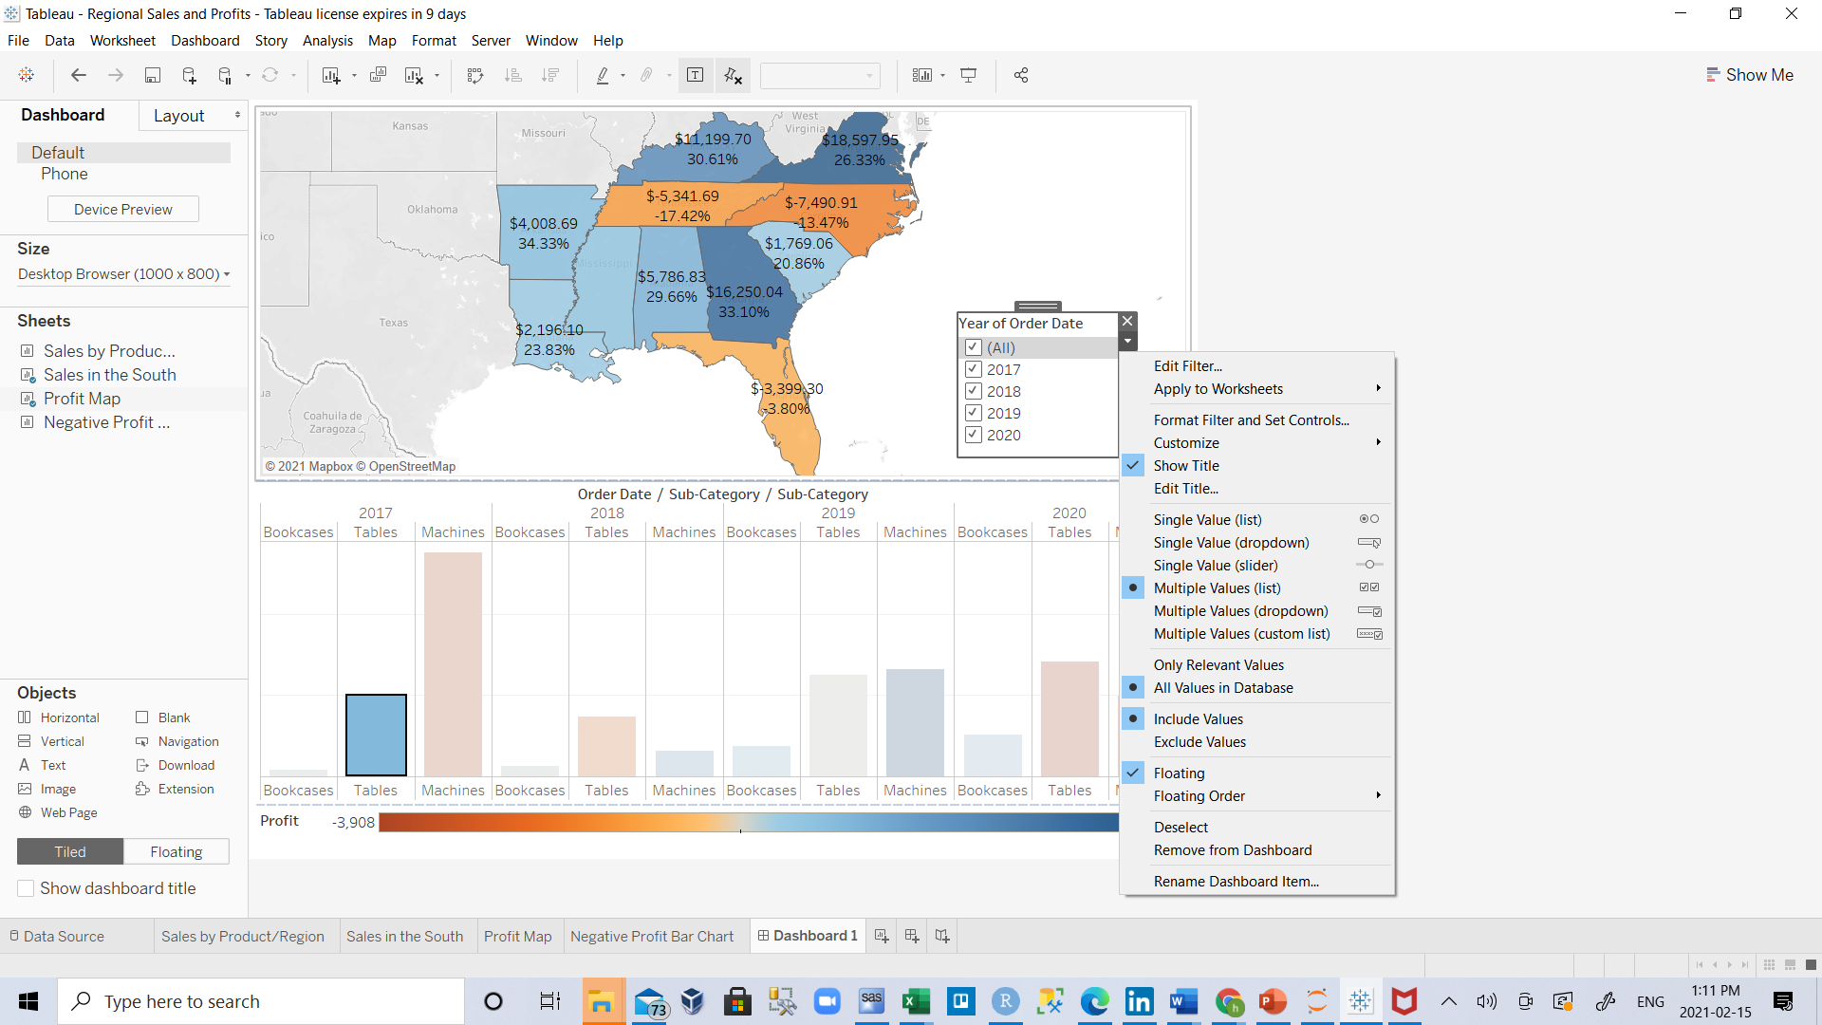
T
Finally, select the remaining Year of Order Date filter, click its drop-down arrow or R.C. on Year of Order Date filter, and then select Floating. Move it to the white space in the map view. In this example, it is placed just off the East Coast, in the Atlantic Ocean.
Try selecting different years on the Year of Order Date filter. Ooh, your data is quickly filtered to show that state performance varies year by year. That's nice, but it could be made even easier to compare.
Click the drop-down arrow at the top of the Year of Order Date filter or R.C. on Year of Order Date filter, and select Single Value (Slider).

Slide 18
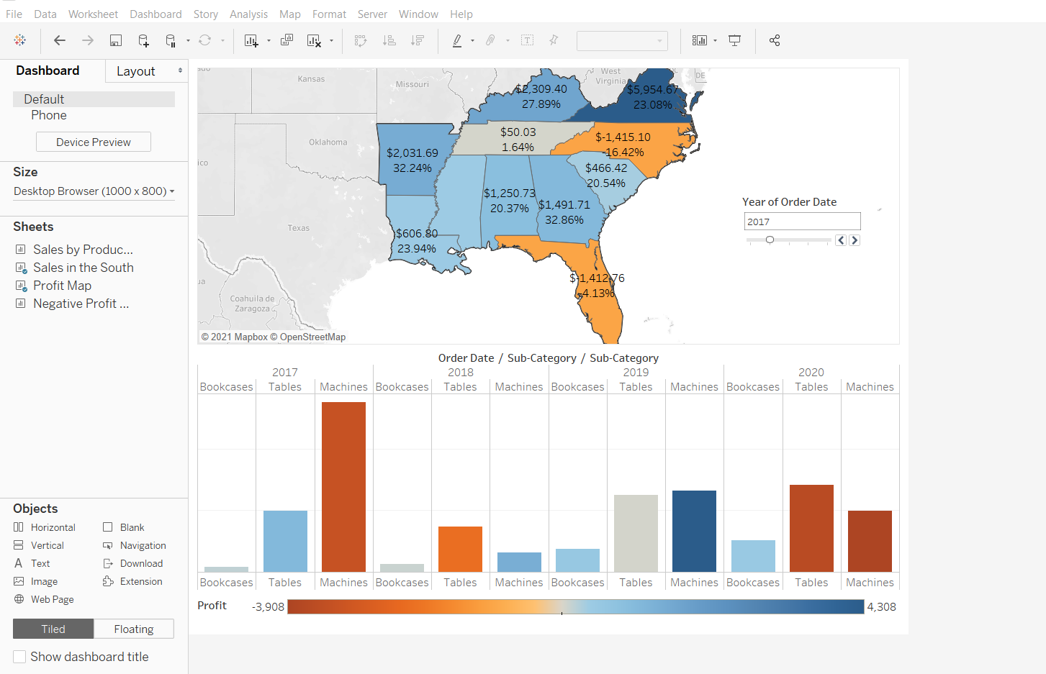
T
Your view updates to look like this:

Slide 19
T
Differentiate Floating vs. Tiled objects on a dashboard
Objects on a dashboard can be set to either Tiled or Floating.
Tiled items are automatically sized to the zone you drop them in. Floating items can be moved and sized freely from other objects on the dashboard. If you want, you can even have both floating and tiled items on the same dashboard.

Slide 20
Create an interactive dashboard

Slide 21
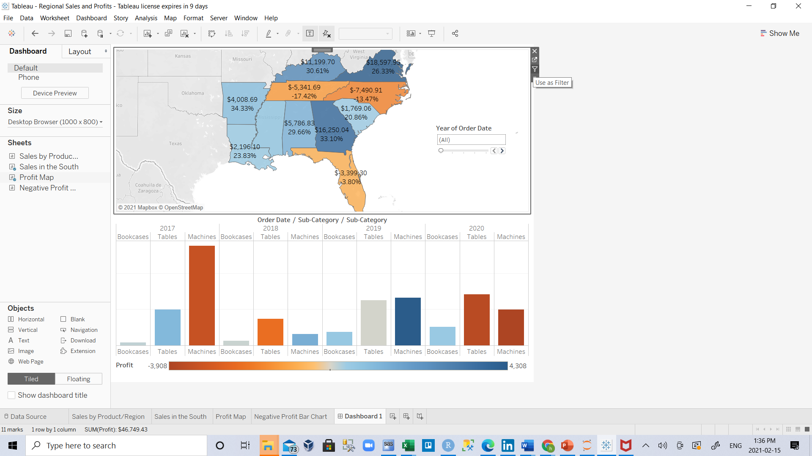
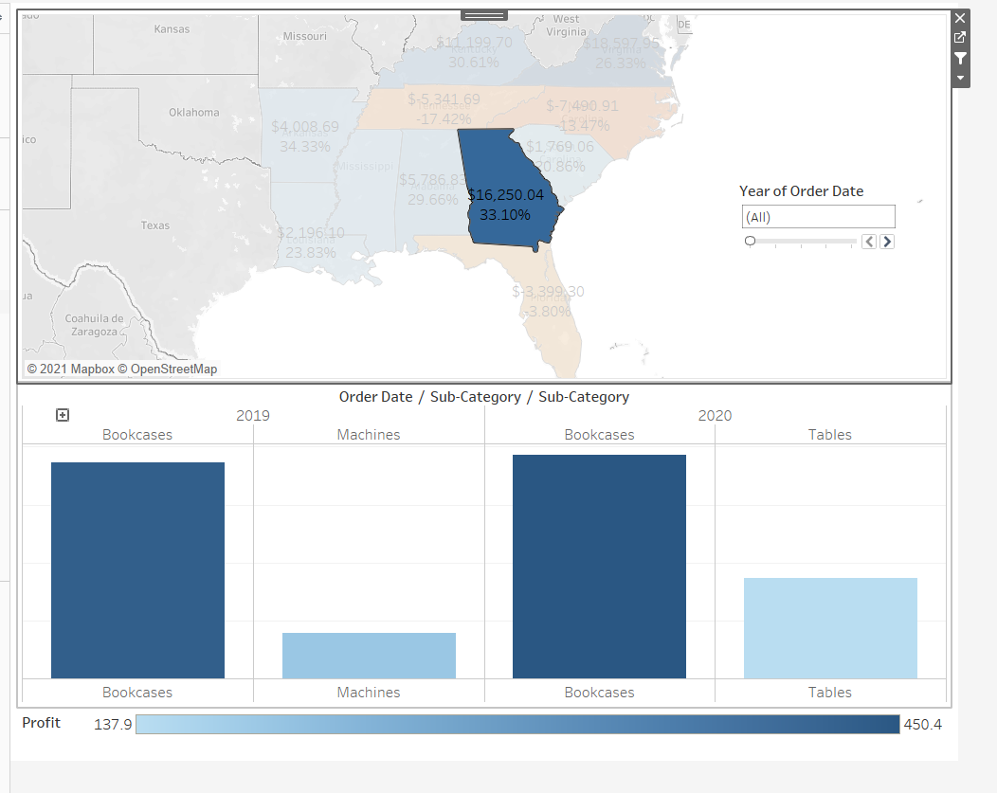
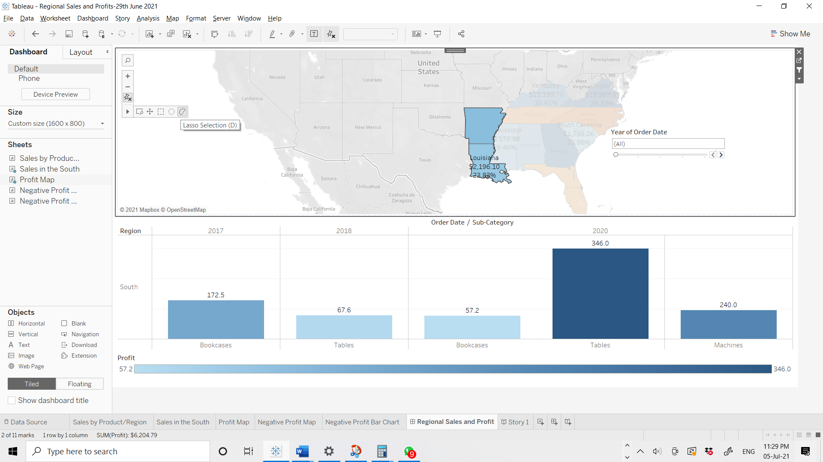
T
Add interactivity
Wouldn't it be great if you could view which sub-categories are profitable in specific states?
Select Profit Map in the dashboard, and click the Use as filter
icon in the upper right-hand corner.
Select a state within the map. For example:
The Sales in the South bar chart automatically updates to show just the sub-category sales in the selected state. You can quickly see which sub-categories are profitable.
Click outside of the U.S. to clear your selection.
Note: you can do multiple selection by holding Ctrl key or selecting one of these 3 methods

Slide 22
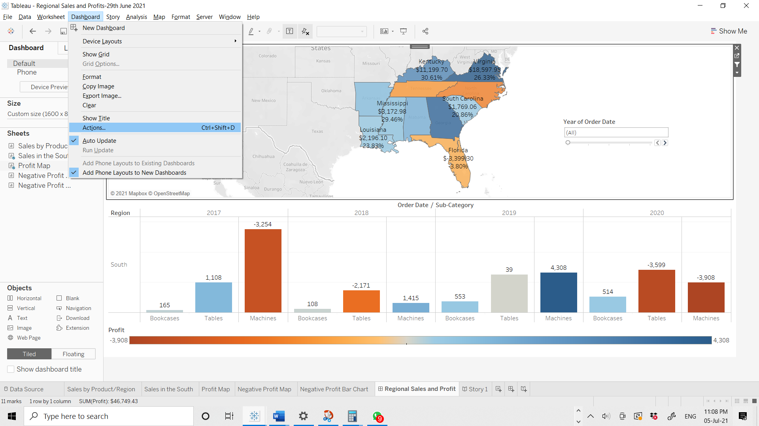
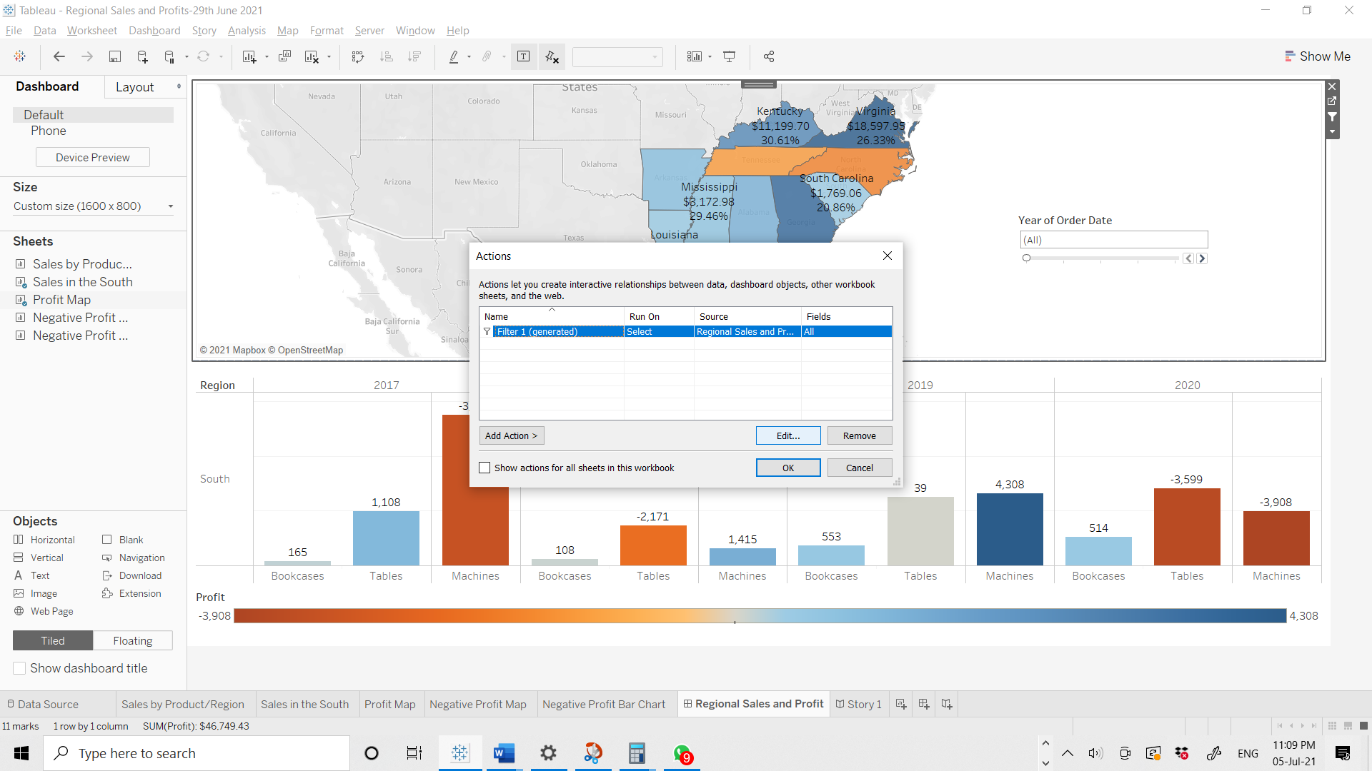
You can edit an action:
Dashboard ➔ Actions… ➔select the action ➔Edit
If we go to Dashboard and we go to actions, you will see that there is an action here already and it's
generated action, meaning it was added automatically.
Now, let's click on this generated action and we'll click edit.
You can Add Action manually by clicking

Slide 23
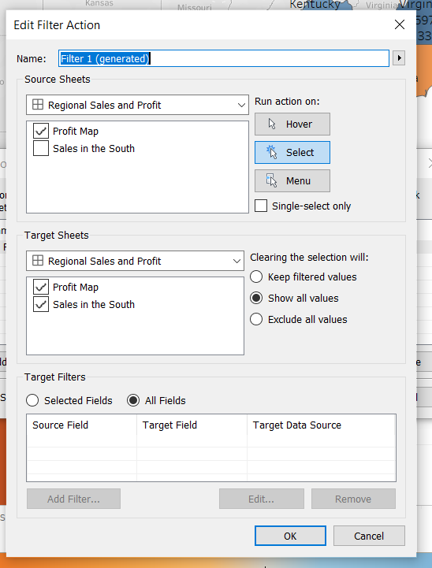
So here you can see that there's a few fields.
First of all, what is the source of the action dashboard?
One is our dashboard that we're looking at.
And in Dashboard one, it is Profit Map that is the source of the action.
The action is run only when you select a certain element.
And once you've selected an element, the action is applied to the target sheets.
The target sheets are the Sales in the South and the Profit Map again.
So in this case, what is going to do is it's going to filter the the Sales in the South .
It won't actually take out the rest of the values from the Profit Map because Tableau Smart, it knows that if you take out the rest of the values from the Profit Map, then you won't be able to click on something else.

Slide 24
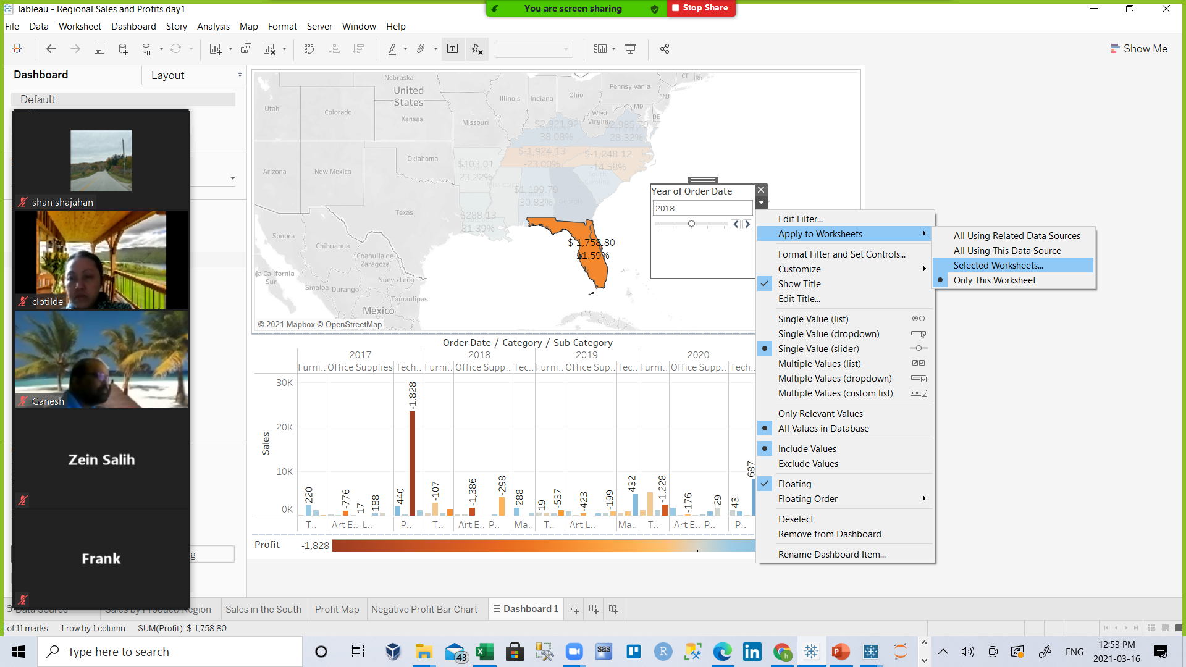
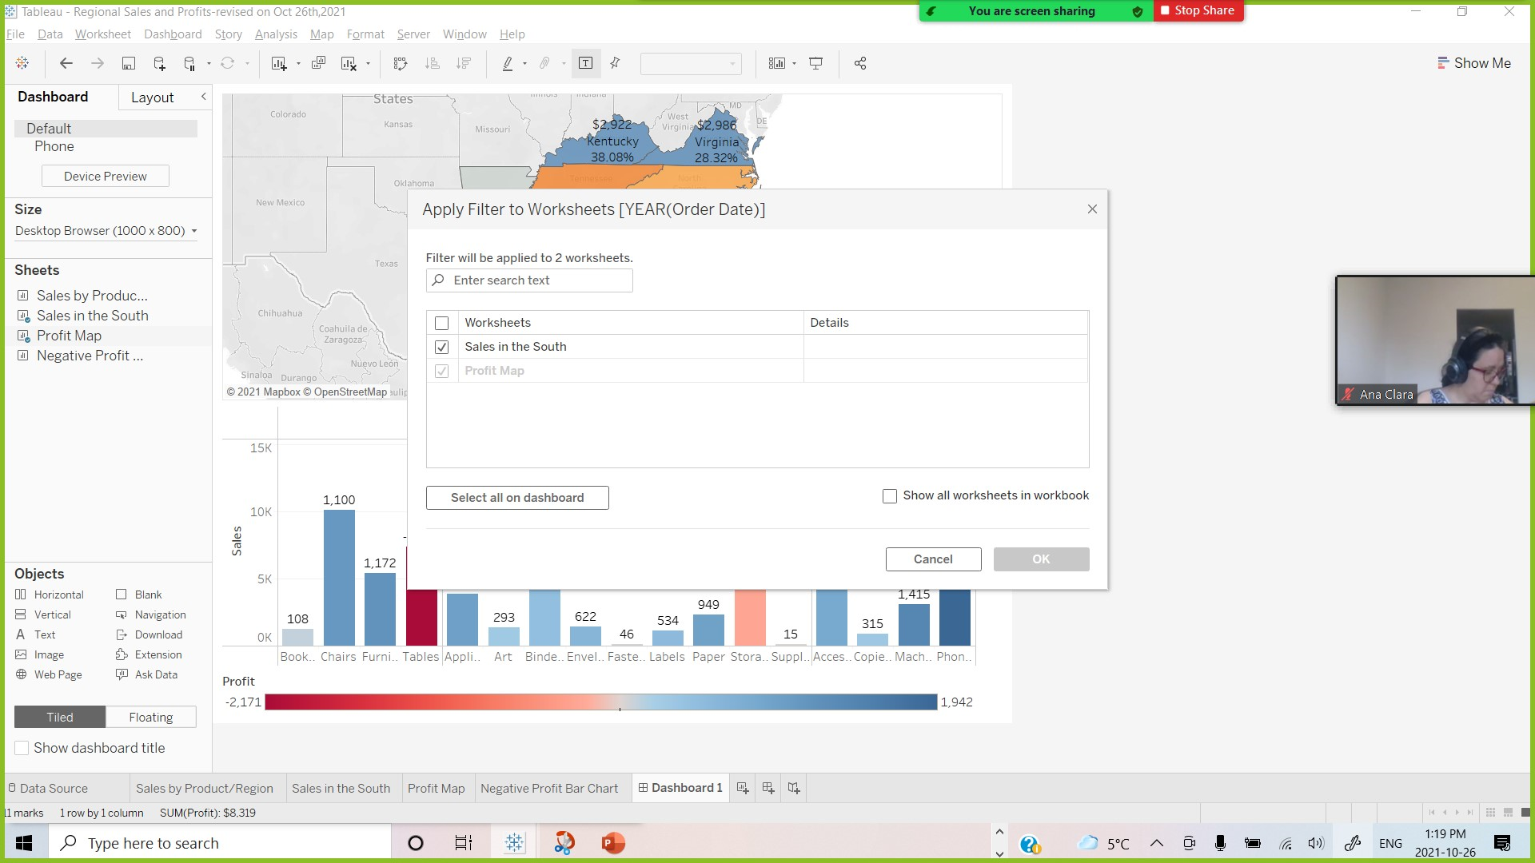
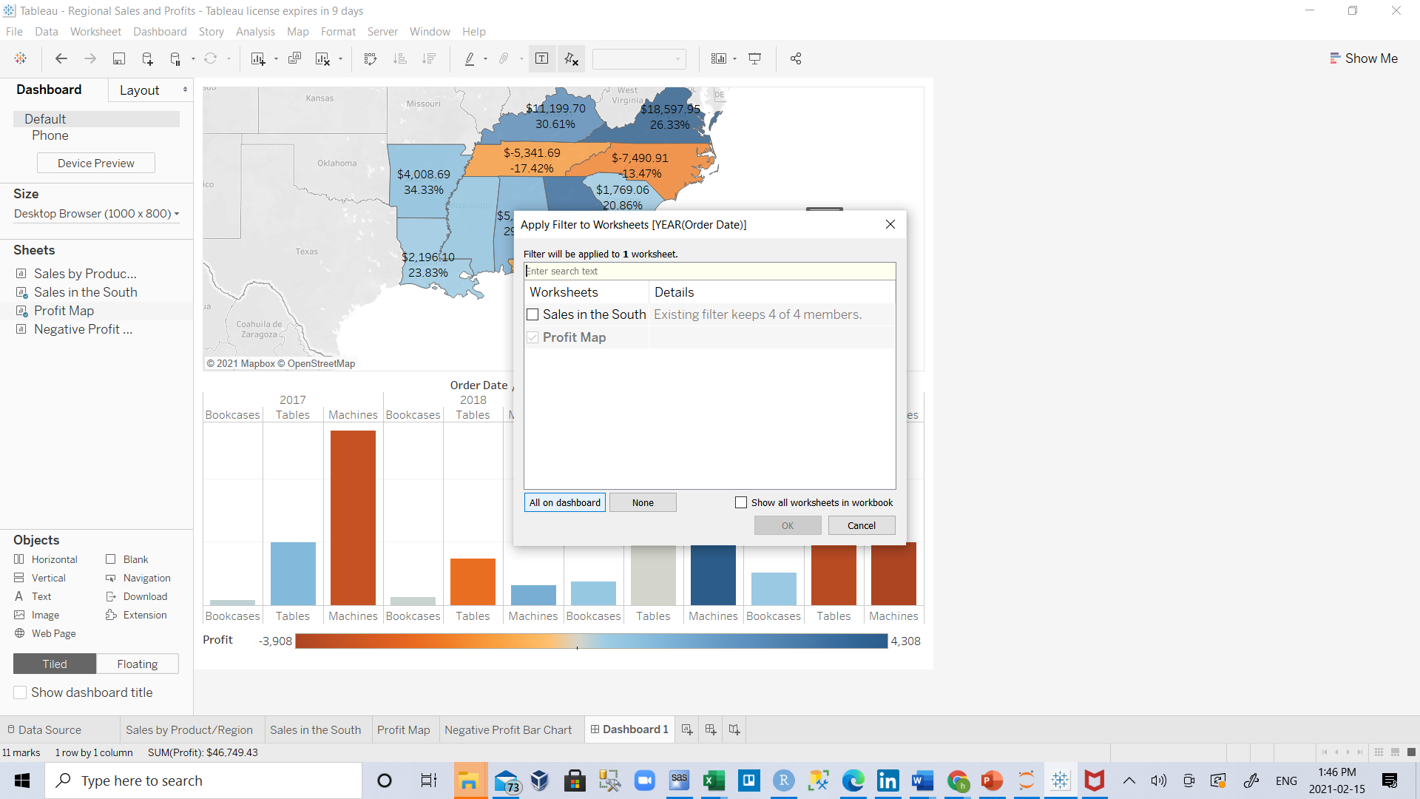
T
You also want viewers to be able to see the change in profits based on the order date.
Select the Year of Order Date filter, click its drop-down arrow, and select Apply to Worksheets > Selected Worksheets.
In the Apply Filter to Worksheets dialog box, select All in dashboard, and then click OK.
This option tells Tableau to apply the filter to all worksheets in the dashboard that use this same data source.

Slide 25
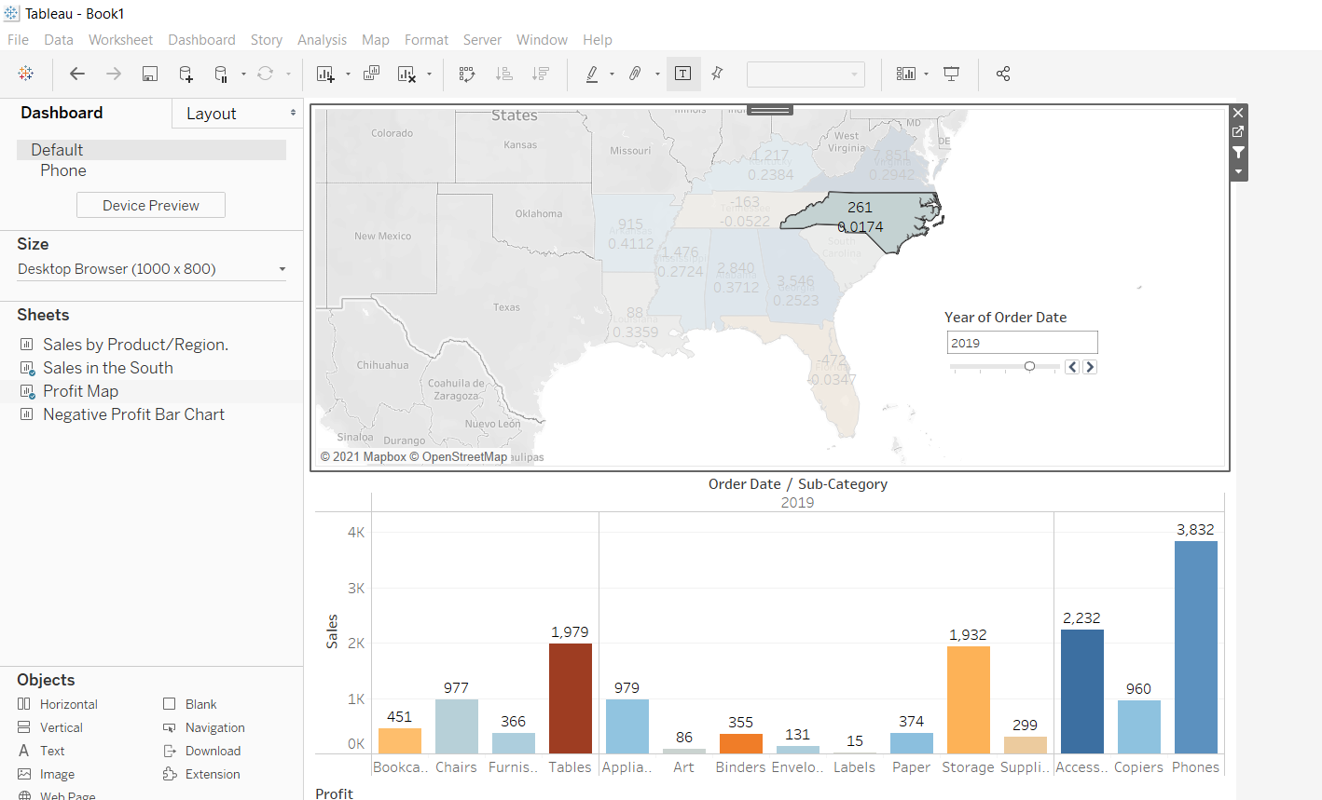
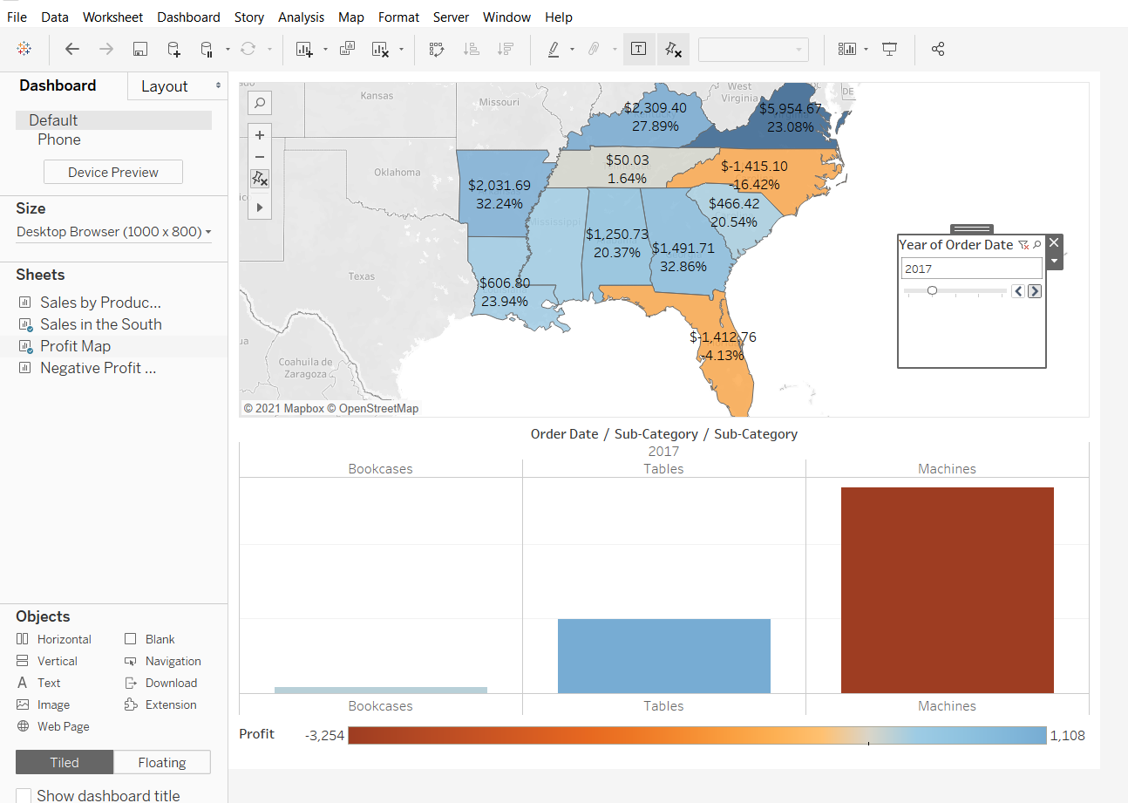
T
Explore state performance by year with your new, interactive dashboard!
Here, we filter Sales in the South to only items sold in North Carolina, and then explore year by year profit.

Slide 26
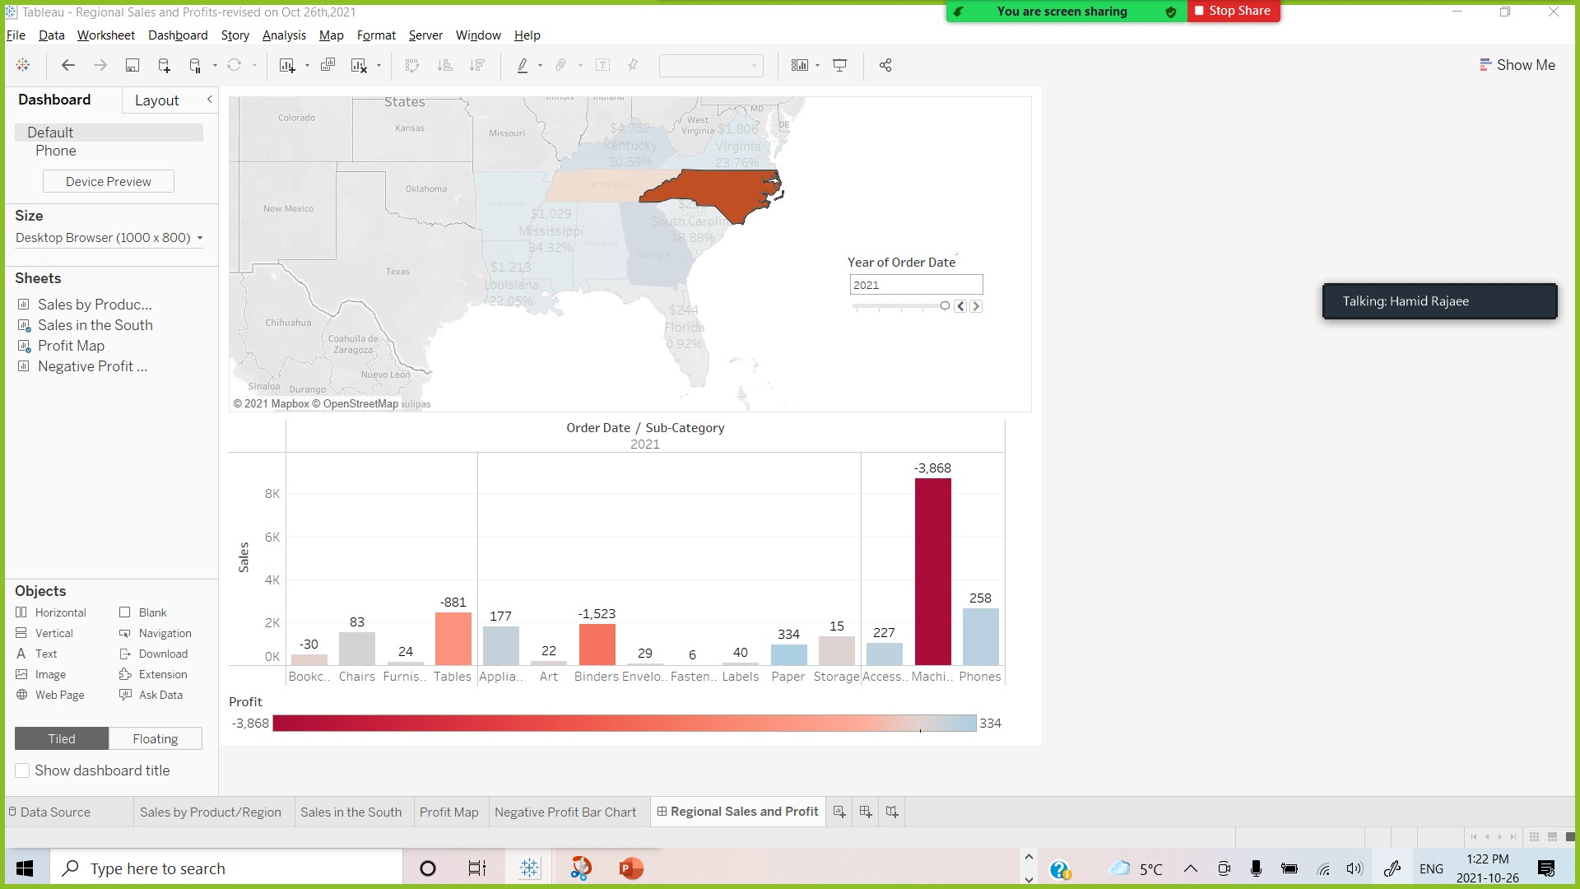
T
Rename and go
You show your boss your dashboard, and he/she loves it. He/She's named it "Regional Sales and Profit," and you do the same by double-clicking the Dashboard 1 tab and typing Regional Sales and Profit.
In him/her investigations, your boss also finds that the decision to introduce machines in the North Carolina market in 2021 was a bad idea.
Your boss is glad he/she has this dashboard to explore with, but he/she also wants you to present a clear action plan to the larger team. You're tasked with creating a PowerPoint with your findings.
Good thing you know about stories in Tableau.

Slide 27
T
Step 7: Build a story to present

Slide 28
T
You want to share your findings with the larger team. Together, you might reevaluate selling machines in North Carolina.
Instead of having to guess which key insights your team is interested in, and including them in a PowerPoint presentation, you decide to create a story in Tableau. This way, you can walk viewers through your data discovery process, and you have the option to interactively explore your data to answer any questions that come up during your presentation

Slide 29
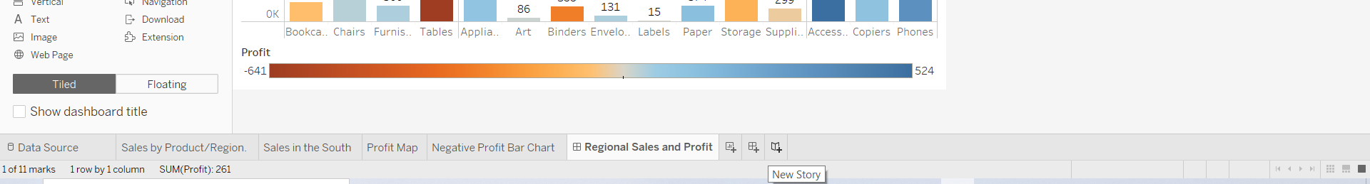
T
Create your first story point
For the presentation, you'll start with an overview.
Click the New story button.

Slide 30
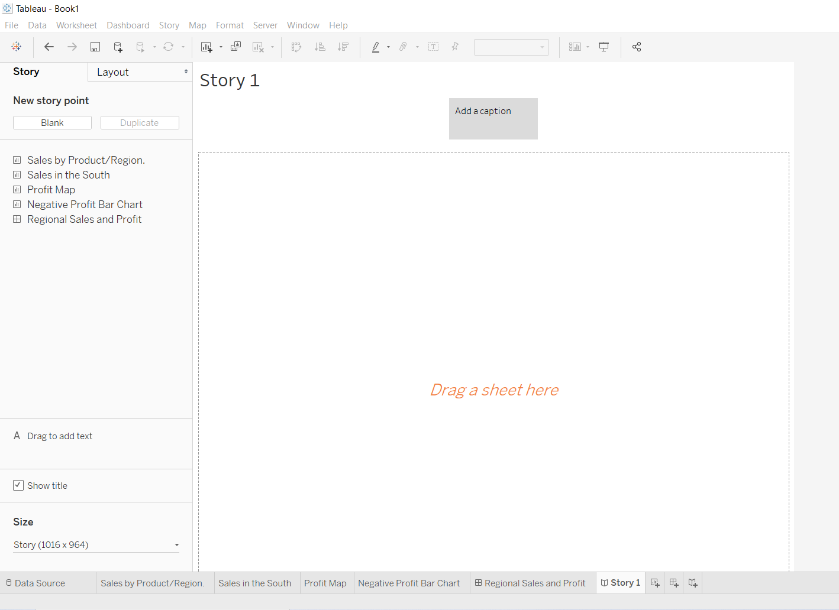
T
You're presented with a blank workspace that reads, "Drag a sheet here." This is where you'll create your first story point.
If you’re thinking that blank stories look a lot like blank dashboards, that's because they do. And like a dashboard, you can drag worksheets over to present them. You can also drag dashboards over to present them in your story.
You should better to change the size to Automatic

Slide 31
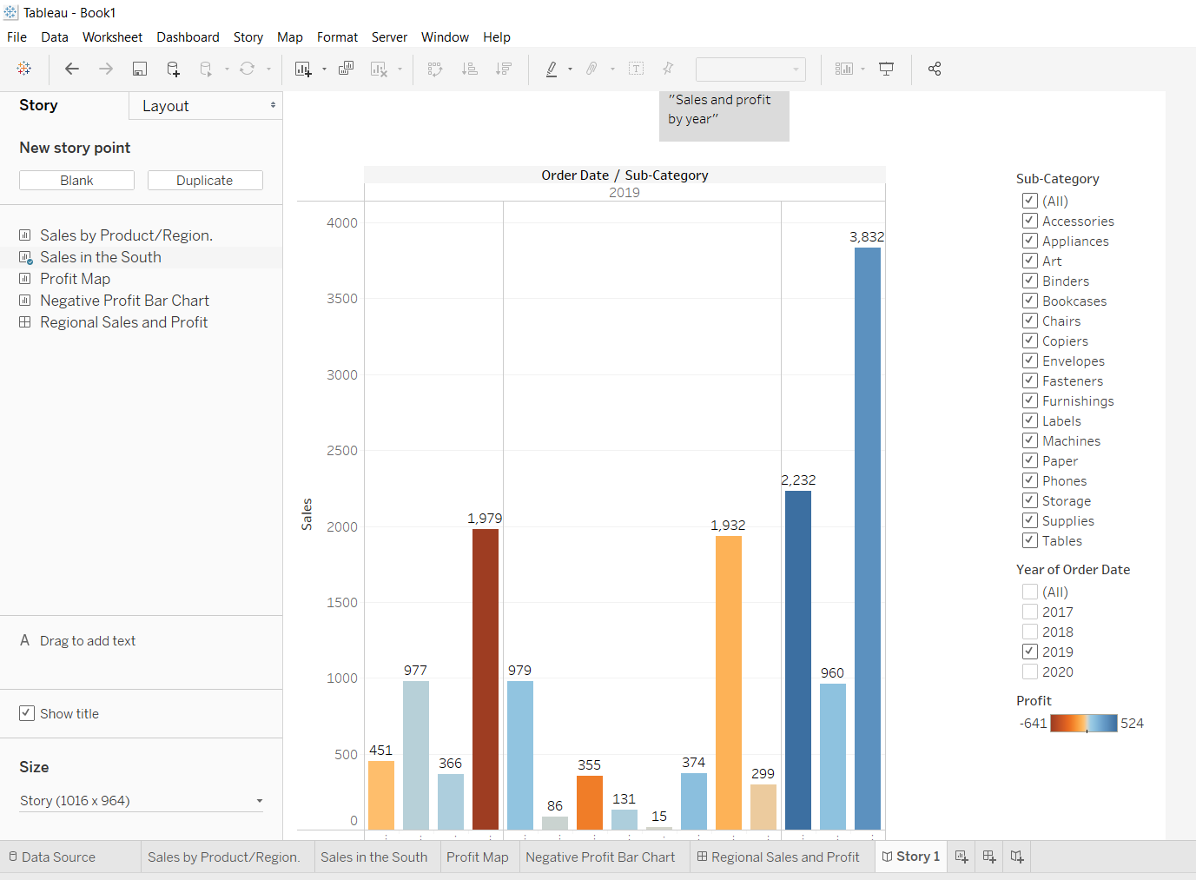
T
From the Story pane on the left, drag the Sales in the South worksheet onto your view.
Add a caption—maybe "Sales and profit by year"—by editing the text in the gray box above the worksheet
This story point will be a useful way to acquaint viewers with your data.
But you want to tell a story about selling machines in North Carolina, so it's time to take a step in that direction

Slide 32
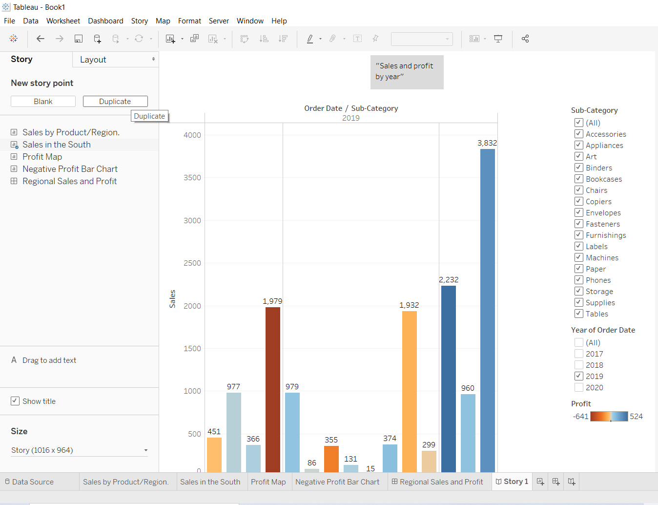
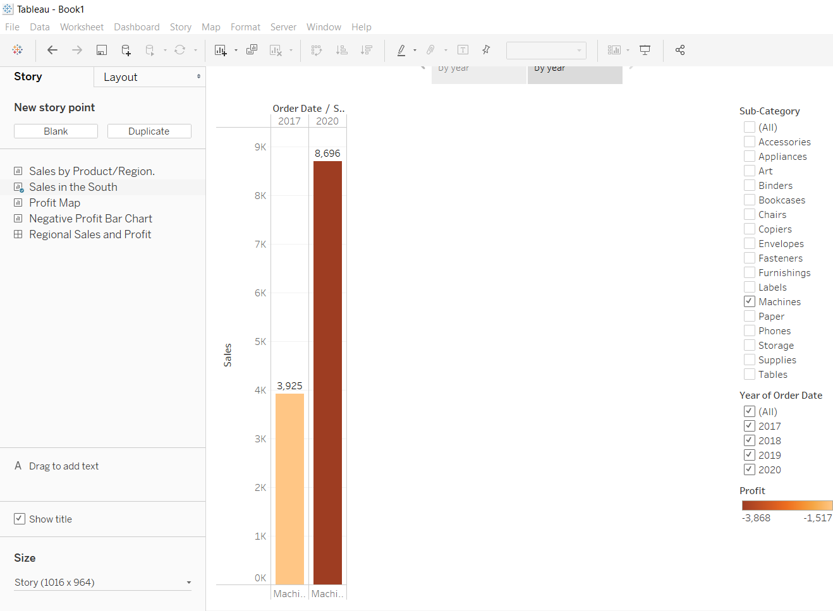
T
Highlight machine sales
To bring machines into the picture, you can leverage the Sub-Category filter included in your Sales in the South bar chart.
In the Story pane, click Duplicate to duplicate the first caption.
Continue working where you left off, but know that your first story point will be exactly as you left it.
Since you know you’re telling a story about machines, on the Sub-Category filter, clear the selection for (All), then select Machines.
Now your viewers can quickly identify the sales and profit of machines by year.

Slide 33
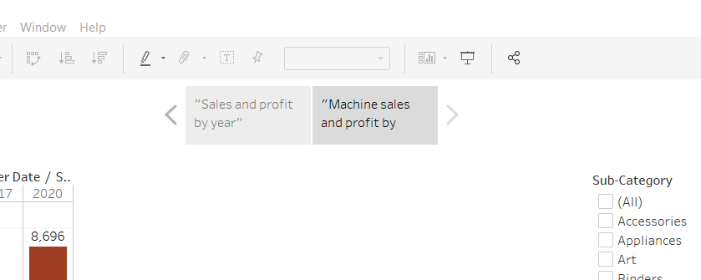
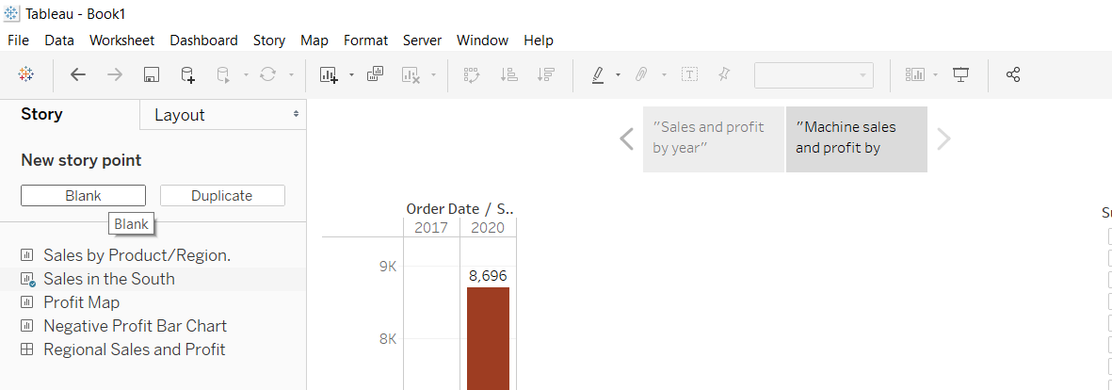
T
Add a caption to underscore what your viewers see, for example, "Machine sales and profit by year."
You've successfully shifted the focus to machines, but you realize that something seems odd: In this view, you can't single out which state is contributing to the loss.
You'll address this in your next story point by introducing your map.
In the Story pane, select Blank.

Slide 34
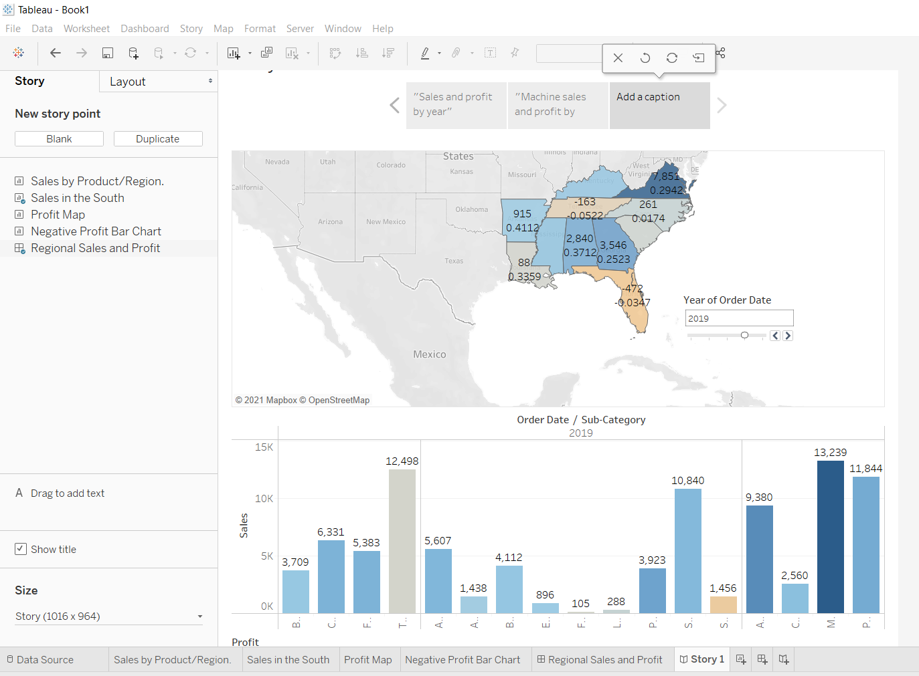
T
Make your point
The bottom line is that machines in NC lose your company money. You discovered that in the dashboard you created. Looking at overall sales and profit by year doesn't demonstrate this point alone, but regional profit can.
Drag your dashboard Regional Sales and Profit onto the canvas.
This gives viewers a new perspective on your data: Negative profit catches the eye.

Slide 35
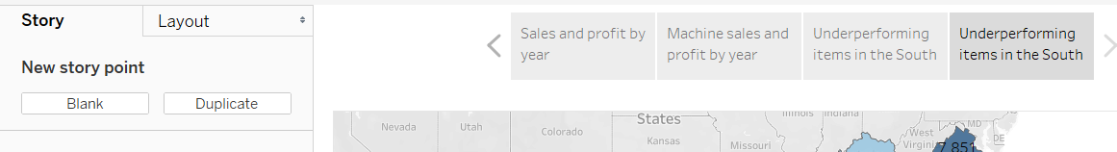
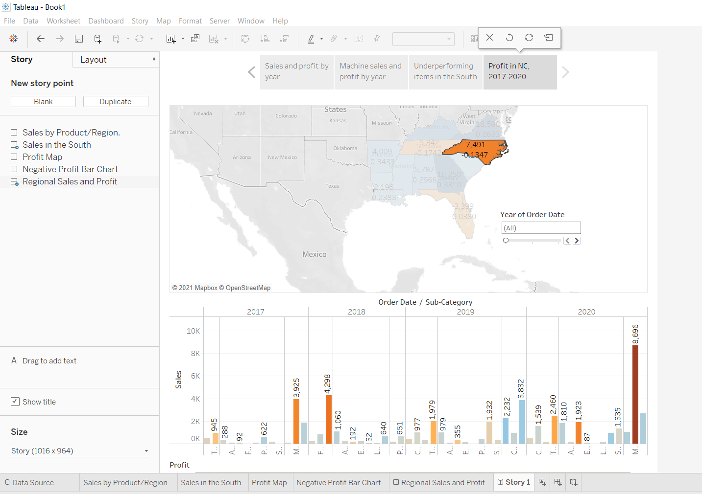
T
Add a caption like, "Underperforming items in the South."
To narrow your results to just North Carolina, start with a duplicate story point.
Select Duplicate to create another story point with your Regional Profit dashboard.
Select North Carolina on the map and notice that the bar chart automatically updates.
Select All on the Year of Order Date filter card.
Add a caption, for example, "Profit in NC, 2017-2020."

Slide 36
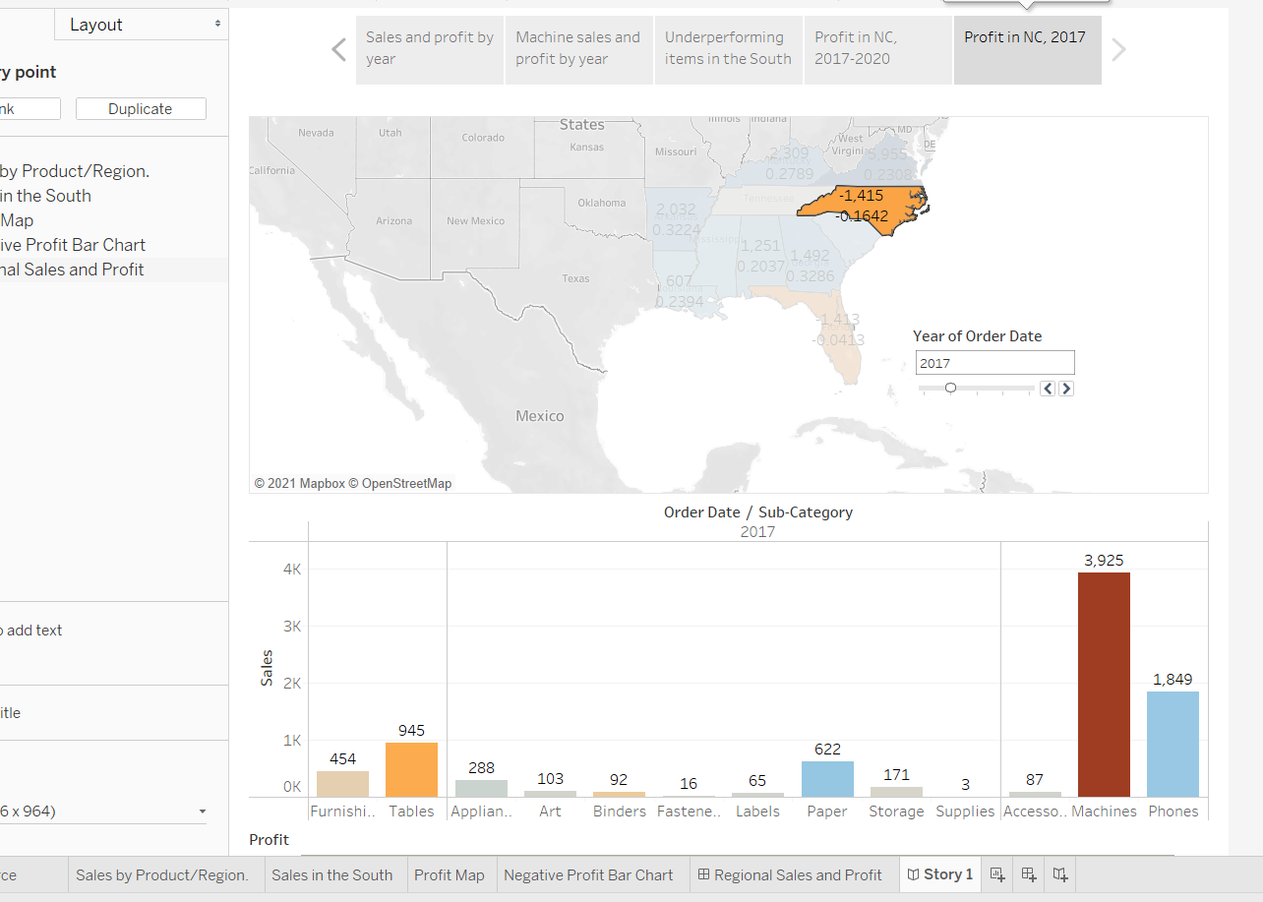
T
Now you can walk viewers through profit changes by year in North Carolina. To do this, you will create four story points:
Select Duplicate to begin with your Regional Profit dashboard focused on North Carolina.
On the Year of Order Date filter, click the right arrow button so that 2017 appears.
Add a caption, for example, "Profit in NC, 2017," and then click Duplicate.
Repeat steps 2 and
3 for years 2018, 2019,
and 2020.
Now viewers will have
an idea of which
products were
introduced to the
North Carolina market
when, and how poorly
they performed.

Slide 37
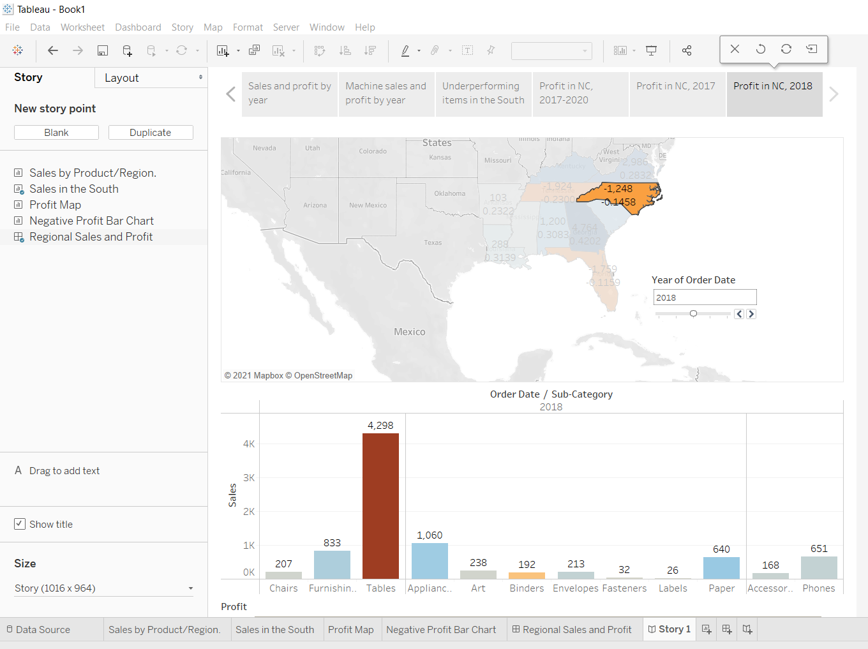
T

Slide 38
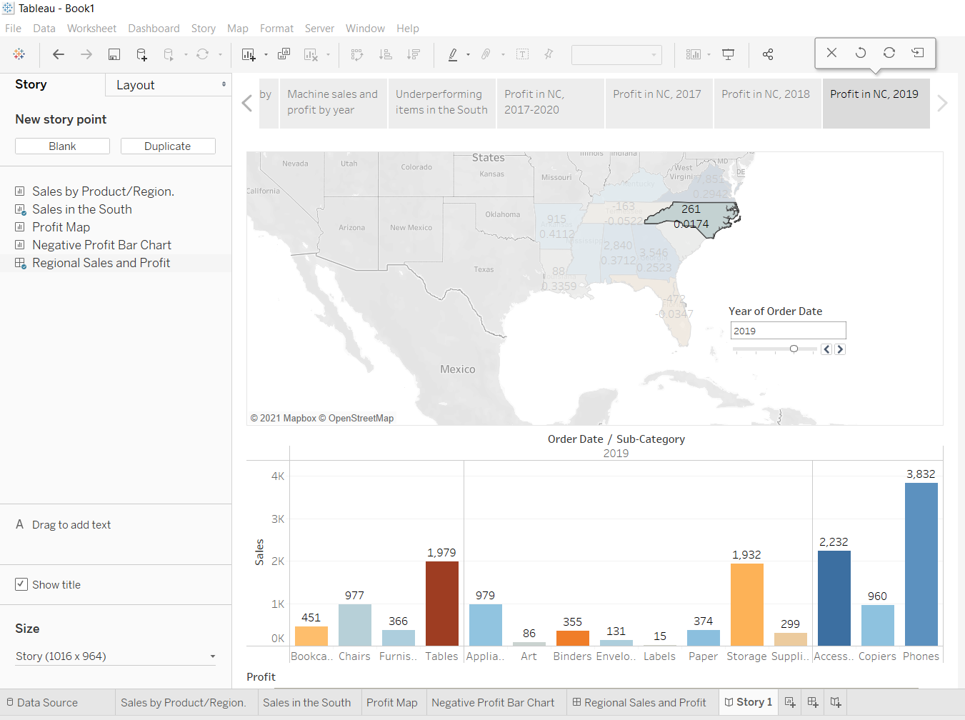
T

Slide 39
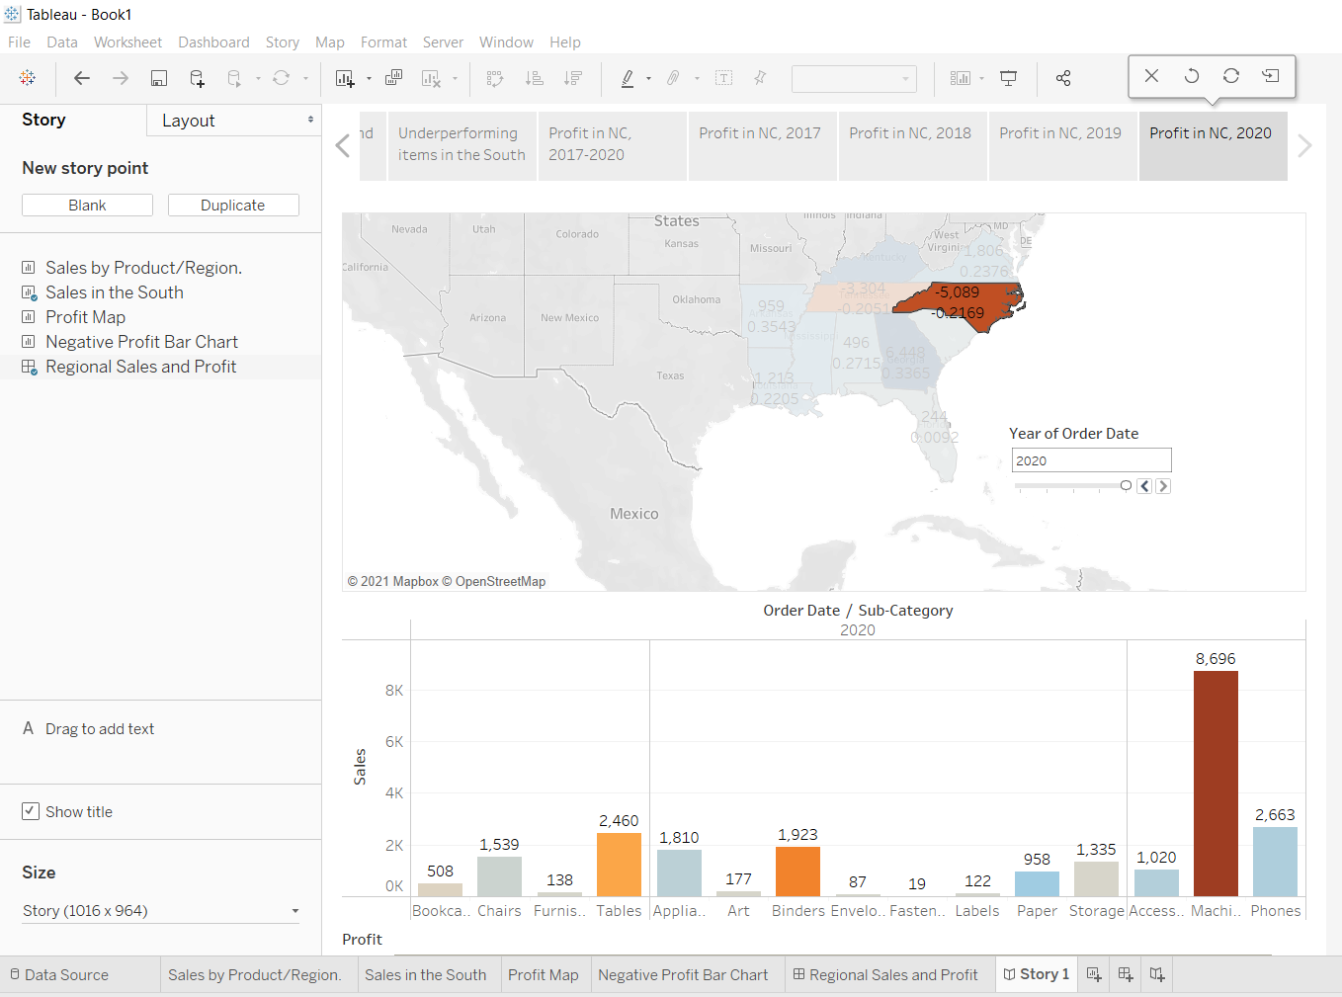
T

Slide 40
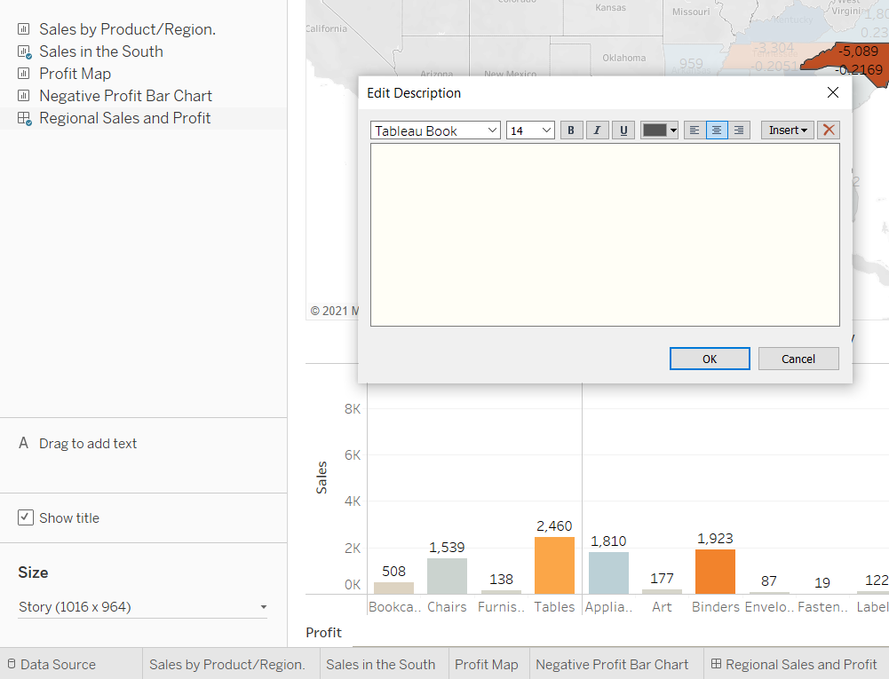
T
Finishing touches
On this story point, which focuses on data from 2020, you want to describe your findings. A caption simply won't do.
In the left-hand pane, select Drag to add text and drag it onto your view.
Enter a description for your dashboard that emphasizes the poor performance of machines in North Carolina, for example, "Introducing machines to the NC market in 2020 resulted in losing a significant amount of money."

Slide 41
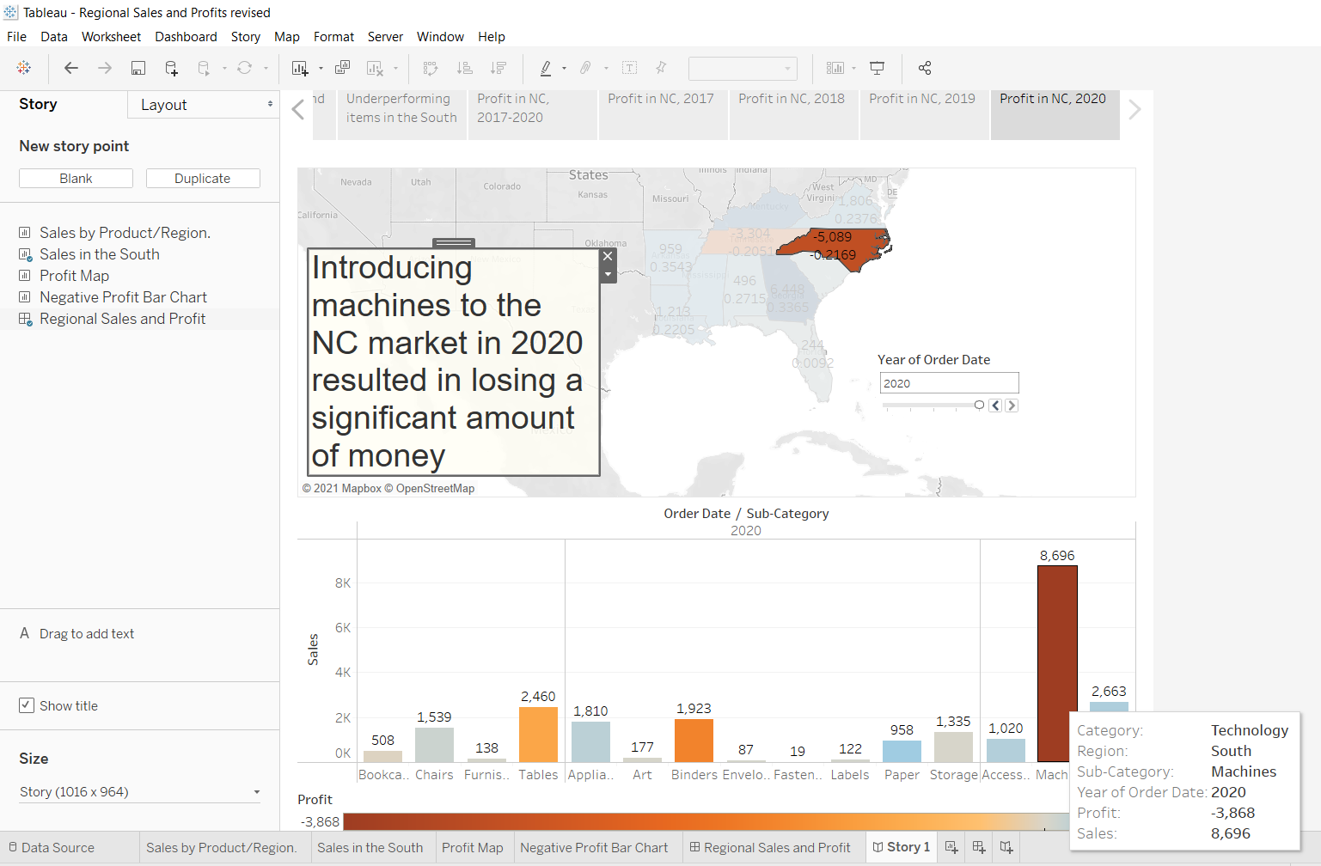
T
For dramatic effect, you'll probably hover over Machines on the Sales in the South bar chart while presenting to show a useful tooltip: the loss of nearly $4,000.

Slide 42
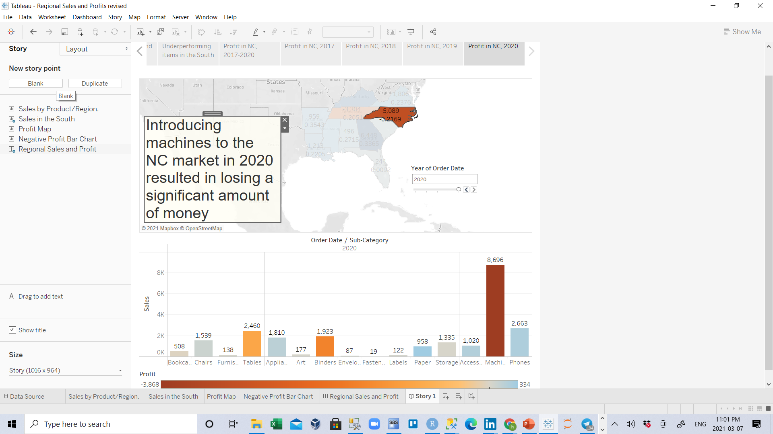
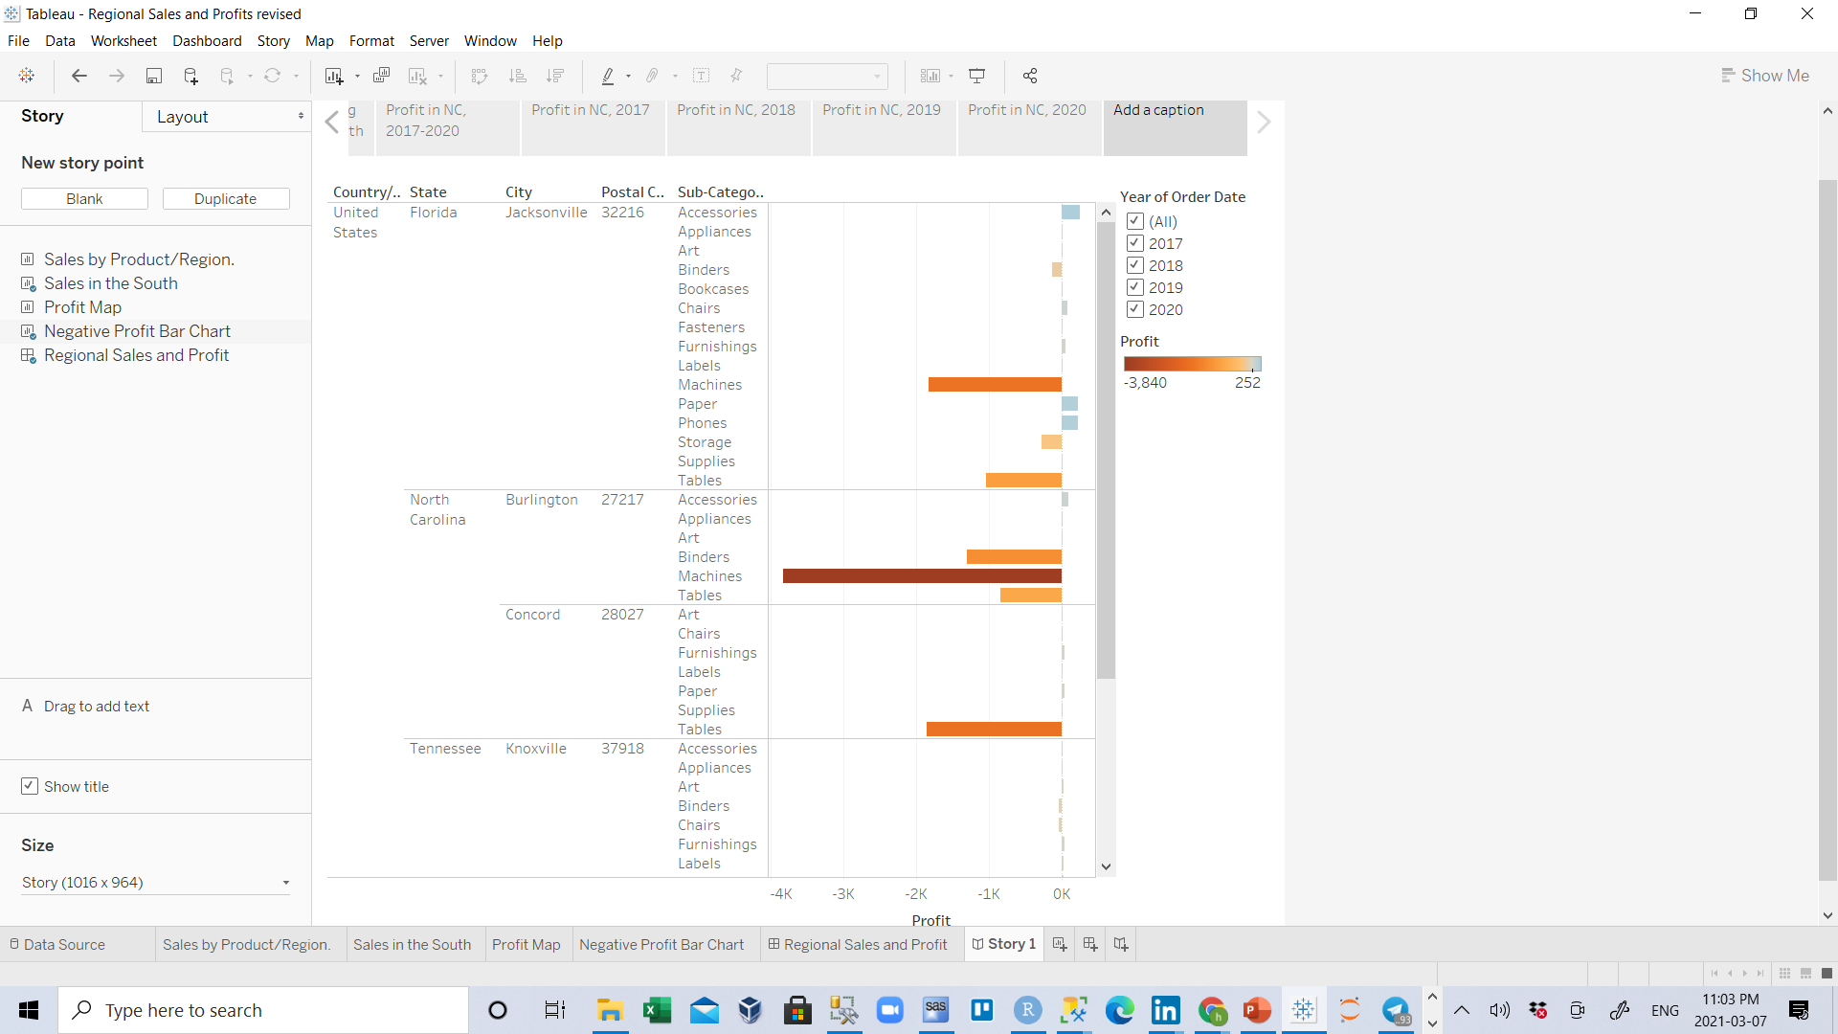
T
And now, for the final slide, you drill down into the details.
3. In the Story pane, click Blank.
4. From the Story pane, drag Negative Profit Bar Chart to the view.

Slide 43

T
5. In the Year of Order Date filter card, narrow the view down to 2020 only.
You can now easily see that the loss of machine profits was solely from Burlington, NC.

Slide 44

T
6. In the view, right-click the Machines in Burlington mark (the bar) and select Annotate > Mark.

Slide 45





T
In the Edit Annotation dialog box that appears, delete the filler text and type: "Machines in Burlington lost nearly $4,000 in 2020."
Click OK.
In the view, click the annotation and drag it to adjust where if appears.
Note: You can double click on the annotation and edit it if you want, For example I will select all the text (by pressing Ctrl +A)and change the font size from 23 to 14.

Slide 46


T
10. Double click on Add a caption and give this story point the caption: "Where are we losing machine profits in NC?"
11. Double-click the Story 1 tab and rename your story to "Improve Profits in the South".

Slide 47

T
12. Review your story by selecting Window > Presentation mode.

Slide 48

T
Size to fit
It seems like your dashboard is too big for the presentation. That's irritating. Press the Esc key to exit your presentation, and then select the Regional Profit sheet at the bottom of your workbook.
In the left-hand pane under Dashboard, change the Size drop-down selection from Desktop to Fit to Improve Profits in the South. This will automatically size your dashboard for optimal story viewing.
Select Fit to Improve Profits in the South and then enter Presentation mode again. Your dashboard fits nicely.

Slide 49
T
After you present
Your presentation went very well. The team is convinced there is work to be done to increase profit in Burlington, NC. Plus, they're curious to know why machines did so poorly in the first place. Your boss is thrilled: Not only have you identified a way to address negative profit, you've got the team asking questions about their data.
To keep the lessons fresh in their minds, your boss asks you to email your team a Word doc with your findings. Good thing you know about sharing your visualizations with Tableau Server and Tableau Public.
Continue to Step 8: Share your findings

Slide 50


Sizing Dashboards and stories
For sizing dashboards, select that dashboard then you can change it by selecting drop down menu in Size area
Or select predefined sizes from here

Slide 51




And for sizing stories, select that story then you can change it by selecting drop down menu in Size area and change width and height or select one of predefined sizessizes

Slide 52

You can do square highlighting(Zoom Area) as well by selecting its icon and then select area

Slide 53

Note : another way to find states with negative profit is using filter , for example R.C. on Profit Map worksheet and select Duplicate

Slide 54

Rename it to Negative Profit Map then drag Profit to filter and select #sum from pop up menu then Next

Slide 55

Then for just showing Negative numbers select At most and type 0 then press ok

Slide 56


Slide 57


Note: You can Edit a Filter by selecting Edit filter from drop down menu of that filter and then change that filter
From pop up menu or add that filter to legend by selecting show filter

Slide 58


and then change that filter, you can even change appearance of showing filter by selecting other types from drop down menu

Slide 59
What is the Tableau Server?
An online platform to host and hold all the tableau workbooks, data sources and related tableau data is called Tableau Server. Tableau developed the server so that all the functionalities of Tableau could be used in the server and it helps to hold the data with the available memory. The workbooks need not be always opened and downloaded with the desktop if tableau functions are used. Access and authorizations could be given so that the files can be kept secure and protect them from hackers. The server can help the employees to collaborate on the work of the project and hence it saves time.
https://www.educba.com/what-is-tableau-server/

